Slide 1
DMCA § 2012 and Education
Paul D. Callister, JD, MSLIS
Library Director & Professor of Law
UMKC School of Law
www1.law.umkc.edu/faculty/callister/presentations/dmca.pptx

Slide 2
Problem
A faculty member wants help with software to “rip” segments from a DVD to use for a presentation in class. Assume the conditions of the TEACH Act will be met.
Can IS rip the DVD?
Would it matter if the movie were on Blue Ray or if it were from an online distribution service ?

Slide 3
DMCA
Circumvention?
“To Rip or Not to Rip,
That is the Question!”

Slide 4
Solving the Problem: The Basic Framework
License
Copyright
Infringement
DMCA

Slide 5
Is Use Prohibited under a License?
Copyrightable
& not in Public
Domain?
DMCA
Circumvention?
Is Prohibition
Enforceable?
TEACH Act,
Library, or Fair Use
Exception ?
DMCA
Exception?
Color Key
License
Copyright
DMCA

Slide 6
Is Use Prohibited under a License?
Copyrightable
& not in Public
Domain?
DMCA
Circumvention?
Is Prohibition
Enforceable?
Fair Use,
Teach Act, or Library
Exemption?
DMCA
Exception?
?
Get
Permission?
?
?
?
?
?
?
?
?
Get
Permission?
Orphan
Work?
Color Key
License
Copyright
DMCA
Yes
No
?
Stop
Go

Slide 7
DMCA
Circumvention?

Slide 8
DMCA
Circumvention?
17 U.S. Code § 1201 – Circumvention
(a)(1)(A) No person shall circumvent a technological measure that effectively controls access to a work protected under this title.
(2) No person shall manufacture, import, offer to the public, provide, or otherwise traffic in any technology, product, service, device, component, or part thereof, that--
(A) is primarily designed or produced for the purpose of circumventing a technological measure that effectively controls access to a work protected under this title . . . .
(3) As used in this subsection--
(A) to "circumvent a technological measure" means to descramble a scrambled work, to decrypt an encrypted work, or otherwise to avoid, bypass, remove, deactivate, or impair a technological measure, without the authority of the copyright owner. . . .
Notes:
(B) a technological measure “effectively controls access to a work” if the measure, in the ordinary course of its operation, requires the application of information, or a process or a treatment, with the authority of the copyright owner, to gain access to the work.

Slide 9
DMCA
Circumvention?
No Fair Use or Teach Act
Exception for Circumvention!

Slide 10
Is Use Prohibited under a License?
Copyrightable
& not in Public
Domain?
DMCA
Circumvention?
Is Prohibition
Enforceable?
Fair Use,
Teach Act, or Library
Exemption?
DMCA
Exception?
?
Get
Permission?
?
?
?
?
?
?
?
?
Get
Permission?
Orphan
Work?
Color Key
License
Copyright
DMCA
Yes
No
?
Stop
Go

Slide 11
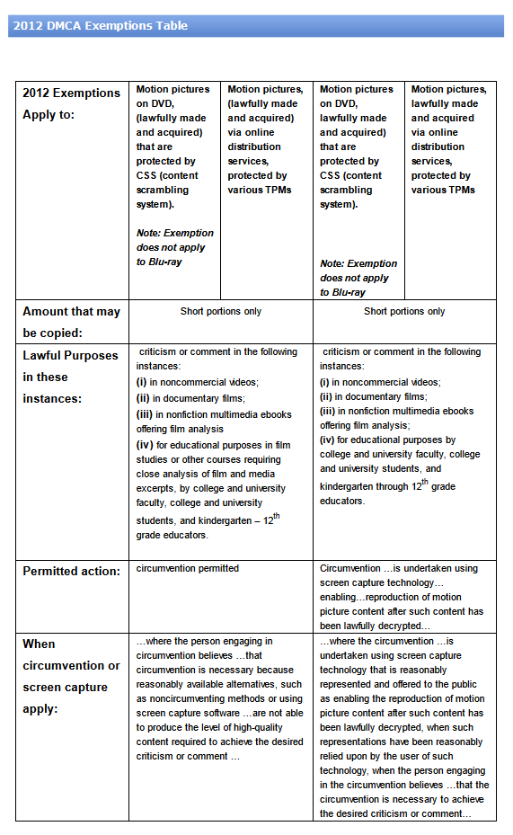
DMCA
Exception?
2012 Copyright Office: Triennial Exceptions
Is the motion picture contained on DVD (not a Blue Ray) with CSS or is it “acquired via online distribution” with Technological Protection Measures (“TPM”)?
Is the use for general “educational purposes” or for “film studies or other courses requiring close analysis of film”?
An affirmative answer to either case 1 means that an exception may apply. However, note that the rule would not apply to Blue Ray discs.
The answer to 2 matters. For general “educational purposes,” you may only use screen capture technology on a lawfully decrypted copy. But for “film studies,” you can use a “ripper” or decrypter.
In either case, you may only use “short portions.”
Source: UMKC Copyright LibGuide: DMCA 2012, by Chris LeBeau
http://libguides.library.umkc.edu/dmca

Slide 12
The End

