Slide 1
Paul D. Callister, JD, MSLIS Director of the Leon E. Bloch Law Library & Professor of Law UMKC School of Law
Copyright in Higher Education in the Aftermath of the Georgia State Cases
http://tinyurl.com/mpamdaw

Slide 2
THE FOLLOWING PRESENTATION IS FOR DISCUSIONAL PURPOSES ONLY AND SHOULD NOT BE CONSTRUED AS OR REPLACE THE NEED FOR OBTAINING LEGAL ADVICE. YOU SHOULD CONSULT AN ATTORNEY.

Slide 3
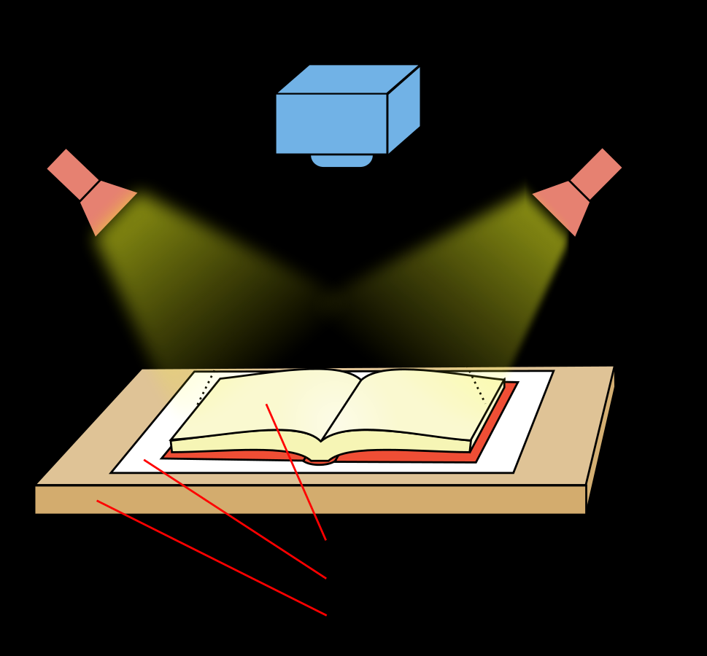
Can you scan a single chapter of a copyrighted book and place it on Blackboard without permission of the author?
Creative Commons Attribution-Share Alike 3.0 Unported license

Slide 4
Part I
Fair Use Checklist

Slide 5
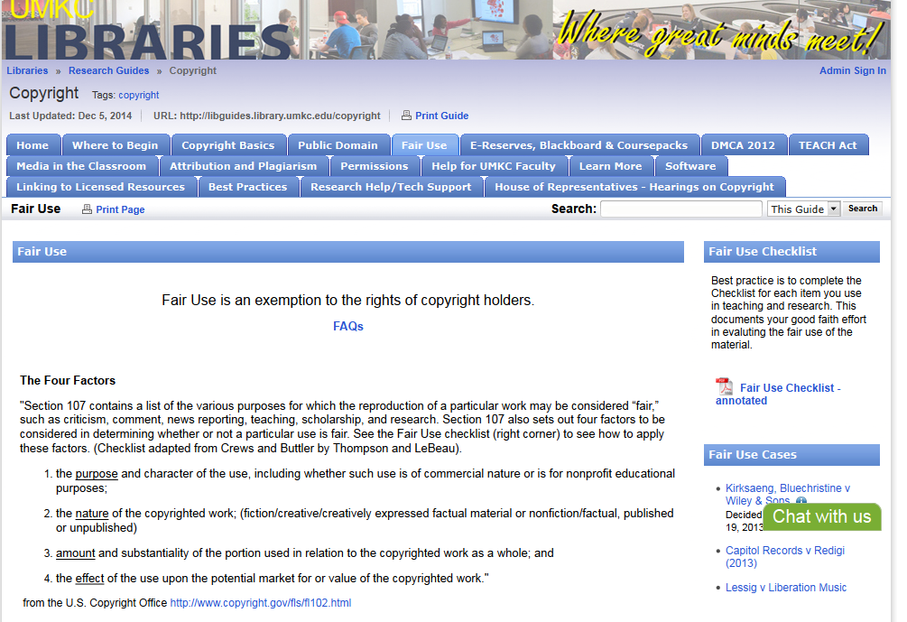

Slide 6
Part II
Georgia State – District Court
(Cambridge Univ. Press v. Becker)

Slide 7
Facts
In 2008, Oxford University Press, Cambridge University Press and Sage Publications sue Georgia State University and several officers “in responsibility” – president, provost, dean of libraries and board of regents for injunctive relief.
University had provided students online access to unauthorized excerpts from scholarly books.
In 2009, university responds by providing copyright training and implementing a “fair use checklist” for faculty to submit when making material available online.
At training, faculty were told “there was no across-the-board answer to [the question of amount], but that under fifteen percent would likely be safe and that under ten percent would be ‘really safe’.”
Not satisfied, publishers continue suit on basis that policy allows continued infringement and set forth 99 instances (later reduced to 75 instances) of infringement of copyright of scholarly books (which were not intended as textbooks)

Slide 8
Georgia State - Impact Desired by Plaintiffs
Proposed injunction
Define fair use by Classroom Copying Guidelines
Lesser of 10% or 1000 words
Limit fair use in any class to only 10% of course readings
90% must be purchased by students or licensed
Give publishers access to LMS (Learning Management System) sites

Slide 9
Dist. Court in applying “fair use” (17 USC § 107)
First factor (Nature of the Use): Court found they were educational uses in all 48 instances of copying book chapters (favors university)
Second factor (Character of Material): Court found to be factual in all instances (favors university)
Third factor (Amount of Use): Court imposed a one chapter or 10% “presumptive” test (if not more than one chapter or 10%, then favors university); if failed other considerations
Fourth factor (Effect on the Market): Court looked at whether licenses were available for electronic excerpts, and if any revenues were generated
Only five instances of infringement found.
Rejected the Classroom Guidelines

Slide 10
Part III
Georgia State – 11th Cir.
(Cambridge Univ. Press v. Patton)

Slide 11
Cir. Court in applying “fair use” (17 USC § 107)
First factor (Nature of the Use): Cir. Court found all uses to be educational.
Second factor (Character of Material): Cir. Court rejected Dist. Court’s characterization that material was either factual or fiction—recognized sliding scale of creativity in factual work.
Third factor (Amount of Use): Cir. Court rejected any “hard evidentiary presumptions” as to the amount of use.
Fourth factor (Effect on the Market): Cir. Court agreed with Dist. Court’s analysis (available licenses for excerpt plus revenue), except that it felt that this factor should outweigh the others.
Rejected the Classroom Guidelines

Slide 12
So can you scan a single chapter of a copyrighted book and place it on Blackboard without permission of the author?

Slide 13
The End
http://tinyurl.com/mpamdaw

