Slide 1
Infopalooza Ed Tech 1
LibGuides, Internet Guides, Copyright Compliance and Your LMS
Paul D. Callister, JD, MSLIS
Director of the Leon E. Bloch Law Library &
Professor of Law
Email callisterp@umkc.edu
http://www1.law.umkc.edu/faculty/callister/presentations/infopalooza1.pptx
© 2013, Paul D. Callister. This work is licensed under a Creative Commons Attribution-NoDerivs 2.5 License. Attribution and licensing information for images and sound effects follow this presentation.

Slide 2
LibGuides

Slide 3
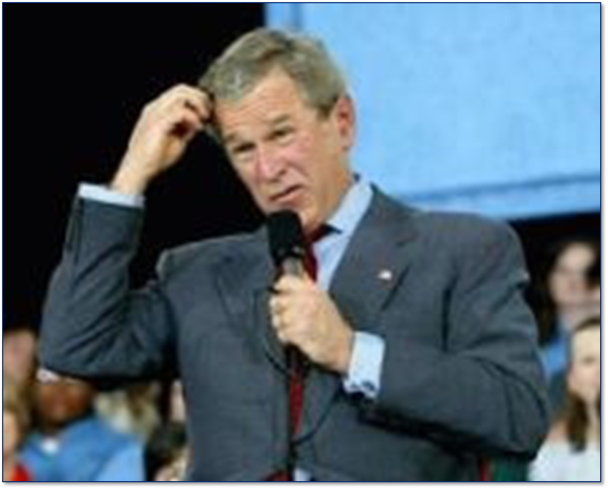
What are they?
Click image for source and licensing restrictions

Slide 4
LibGuides are sets of web pages for research assistance, subject guides, and useful resources compiled by us, your friendly librarians! You may find LibGuides for specific courses or assignments. Or you will find LibGuides on general topics.
Source: http://libanswers.lorainccc.edu/a.php?qid=8645

Slide 5
What can they do?

Slide 6
Explain Concepts

Slide 7
Guide Students to Resources ….

Slide 8
… Free Stuff

Slide 9
… Subscription Resources
$

Slide 10
… Special and Custom Search Engines

Slide 11
… Play Movies

Slide 12
… Explain How to Use the Online Catalog and Inter-Library Loan

Slide 13
… Connect to a specific treatise

Slide 14
… Connect to an eBook

Slide 15
Internet Guides

Slide 16
Lexis Zimmerman’s Research Guides

Slide 17
Law Library of Congress

Slide 18
GlobaLex

Slide 19
LLRX

Slide 20
Learning Management Systems

Slide 21
Why?
Management of Course
Better Pedagogy
Need for Full Use of Library Collaborative Technology Classroom

Slide 22
LMS and Copyright Compliance

Slide 23
How much can I post?
Impact of Georgia State (Cambridge University Press v. Becker (N.D. Ga 2012)) on Higher Education

Slide 24
Facts
In 2008, Oxford University Press, Cambridge University Press and Sage Publications sue Georgia State University and several officers “in responsibility” – president, provost, dean of libraries and board of regents for injunctive relieve
University had provided students online access to unauthorized excerpts from scholarly books.
In 2009, university responds by providing copyright training and implementing a “fair use checklist” for faculty to submit when making material available online.
At training, faculty were told “there was no across-the-board answer to [the question of amount], but that under fifteen percent would likely be safe and that under ten percent would be ‘really safe’.”
Not satisfied, publishers continue suit on basis that policy allows continued infringement and set forth 99 instances (later reduced to 75 instances) of infringement of copyright of scholarly books (which were not intended as textbooks)

Slide 25

Georgia State - Impact desired by plaintiff
Proposed injunction
  Define fair use by Classroom Copying Guidelines
    Lesser of 10% or 1000 words
  Limit fair use in any case to only 10% of course readings
    90% must be purchased by students or licensed
      Student copyright fee?
    How would Annual Campus License work?
  Give publishers access to LMS sites

Slide 26
Georgia State - Impact Desired by Plaintiff
Proposed injunction
  Define fair use by Classroom Copying Guidelines
    Lesser of 10% or 1000 words
  Limit fair use in any class to only 10% of course readings
    90% must be purchased by students or licensed
  Give publishers access to LMS sites

Slide 27
No Fair Use Example 1 – Sage Handbook Qualitative Research 3d
First two factors favor defendants.
Professor Kaufmann uploaded 4 chapters representing 8.38%
Book had more than ten chapters
Court ruled that amount “was not decidedly small” and that factor three weighed in favor of the Plaintiffs.
No harm to book sales, but plaintiff showed “ready marked for digital excerpts . . . . through CCC and Sage’s in house program.”
Court found “very small, but actual, damage.”
Court found potential damages from “lost permissions income” because of “widespread use of similar unlicensed excerpts.
Factor four strongly favors plaintiff.
To break the tie and find no fair use, court reweighted the factors. Found Kaufman “significantly” exceeded the chapter limit, that the excerpts were an important part of the value of the work ($11,125.91 from Sage in 2009), and that there was “substantial demand” for excerpts.

Slide 28
Fair Use Example 2 – Assessing Speaking
First two factors favor defendants.
Professor Kim uploaded two chapters or 29.82%
Book had eight chapters
Court ruled that amount “was not decidedly small” and that factor three weighed in favor of the Plaintiffs.
No harm to book sales (still in print), because court inferred that professor would not have required students to purchase the whole.
Court found that there was no evidence that “digital excerpts were available for licensing”
Factor four favors defendants
Court finds fair use.

Slide 29
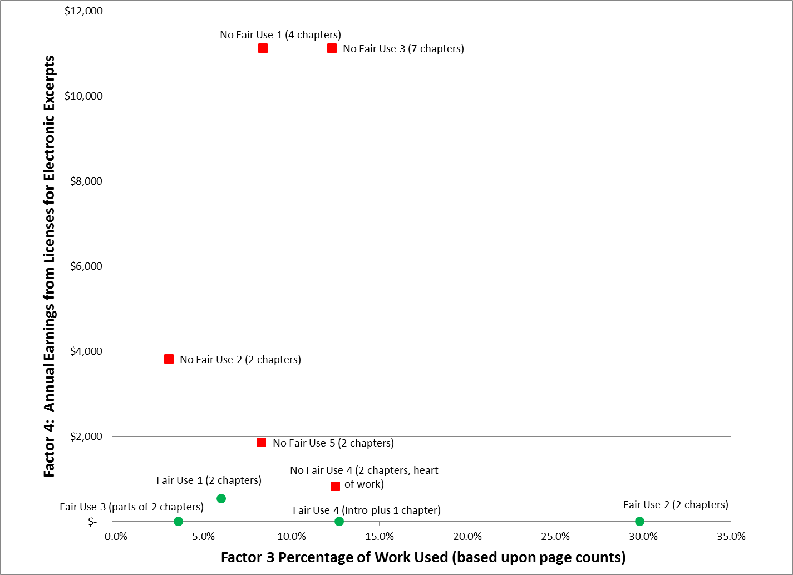
When did the Court Not find Fair Use?
Of the 75 instances before the Court, this chart compares positive four fair use examples (green circles) with five instances where no fair use was found (red squares)

Slide 30
Lessons Learned:
Instead of Uploading a Whole Chapter or Article, Link to the Resources

Slide 31
How?

Slide 32
Or

Slide 33
Like this
Bloomberg Law > US Income Portfolios > U.S. Income Portfolios: Compensation Planning > Portfolio 350-1st: Plan Selection — Pension and Profit-Sharing Plans > Detailed Analysis > Introduction: The Problem of Plan Selection

Slide 34
Finding Free Images
See also, Libguide: Creative Commons For Faculty
by Brenda Dingley

Slide 35
The End

