Slide 1
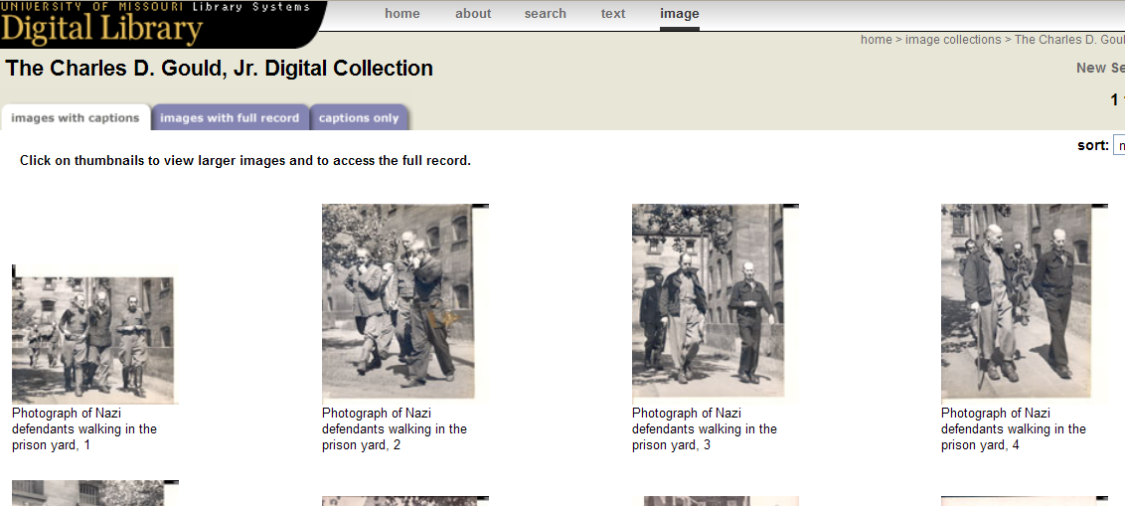
Problem 3
Photographs from the Nuremburg Trials have been donated to your library with the request that they be digitized. Can you give permission to use them in a movie?

Slide 2
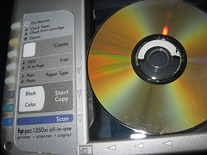
§ 106 Exclusive Rights in Copyrighted Works
Copyright
Subject to sections 107 through 122 through, the owner of copyright under this title has the exclusive rights to do and to authorize any of the following:
(1) to reproduce the copyrighted work in copies or phonorecords;
(2) to prepare derivative works based upon the copyrighted work;
(3) to distribute copies or phonorecords of the copyrighted work to the public by sale or other transfer of ownership, or by rental, lease, or lending;
A "derivative work" is a work based upon one or more preexisting works, such as a translation, musical arrangement, dramatization, fictionalization, motion picture version, sound recording, art reproduction, abridgment, condensation, or any other form in which a work may be recast, transformed, or adapted. 17 USC § 101

Slide 3
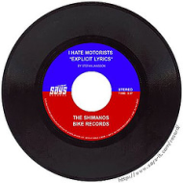
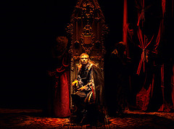
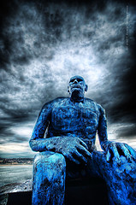
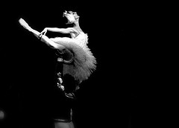
§ 106 Exclusive Rights in Copyrighted Works
Copyright
(4) in the case of literary, musical, dramatic, and choreographic works, pantomimes, and motion pictures and other audiovisual works, to perform the copyrighted work publicly;
(5) in the case of literary, musical, dramatic, and choreographic works, pantomimes, and pictorial, graphic, or sculptural works, including the individual images of a motion picture or other audiovisual work, to display the copyrighted work publicly; and
(6) in the case of sound recordings, to perform the copyrighted work publicly by means of a digital audio transmission.
“in a digital or other non-analog format.” 17 USCS § 101

Slide 4
Back to Problem 3
Photographs from the Nuremburg Trials have been donated to your library with the request that they be digitized. Can you give permission to use them in a movie?

Slide 5
Is Use Prohibited under a License?
Copyrightable
& not in Public
Domain?
DMCA
Circumvention?
Is Prohibition
Enforceable?
TEACH Act,
Library, or Fair Use
Exception ?
DMCA
Exception?
?
Get
Permission?
?
?
?
?
?
?
?
?
Get
Permission?
Orphan
Work?
Color Key
License
Copyright
DMCA
Yes
No
?
Stop
Go

Slide 6
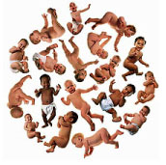
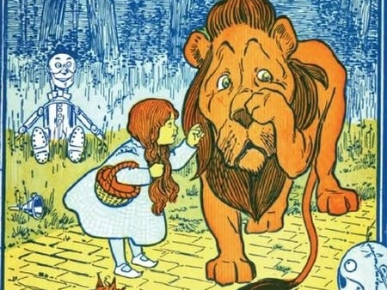
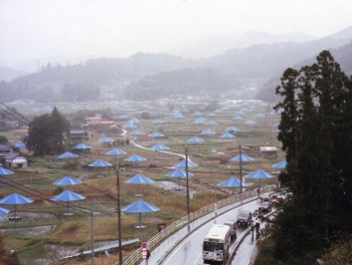
Copyrightable?
Copyrightable
& not in Public
Domain?
Photo of “floating babies” not reproduced for online posting. See Gentieu v. Muller & Co., 712 F.Supp 740 (W.D. Mo. 1989) (“not expanded on idea of photograph, . . . Limited to copying . . . her work”); Getty. Gentieu v. Tony Stone Images/Chicago Inc. et al, 255 F. Supp. 2d 838 (N.D. Ill, 2003); Photo Lawyer, Gentieu Litigation Shows Brute Force of the Courts, Feb 28, 2007, at http://nylawline.typepad.com/photolawyer/2007/02/gentieu_litigat.html
Has to be fixed in a tangible medium of expression
Expression not the idea
Originality (as in being the originator) and modicum of creativity, not novelty (don’t have to be first)
See Hearn v. Meyer, 644 F.Supp. 832 (S.D.N.Y. 1987) (Reproduction of Reproduction: Mere insignificant variations in coloration not alleged to be created intentionally, “mere slavish copies” )….
1991 Umbrella Project (Japan)
W.W. Denslow, Wizard of Oz

Slide 7
1991 Umbrella Project(Japan) : Christo und Jeanne-Claude, photo by DDdeco
Copyrightable ?
Not Fixed

Slide 8
Copyrightable ?
Photo of “floating babies” not reproduced for online posting. See Gentieu v. Muller & Co., 712 F.Supp 740 (W.D. Mo. 1989) (“not expanded on idea of photograph, . . . Limited to copying . . . her work”); Getty. Gentieu v. Tony Stone Images/Chicago Inc. et al, 255 F. Supp. 2d 838 (N.D. Ill, 2003); Photo Lawyer, Gentieu Litigation Shows Brute Force of the Courts, Feb 28, 2007, at http://nylawline.typepad.com/photolawyer/2007/02/gentieu_litigat.html
Notes:
The particular expression is copyrightable, but not the floating baby idea.

Slide 9
Save Planet Earth, by V2 See Mead v. United States, 27 F. Cl. 367 (Fed. Cl. 1992) (an idea not an expression).
Copyrightable ?

Slide 10
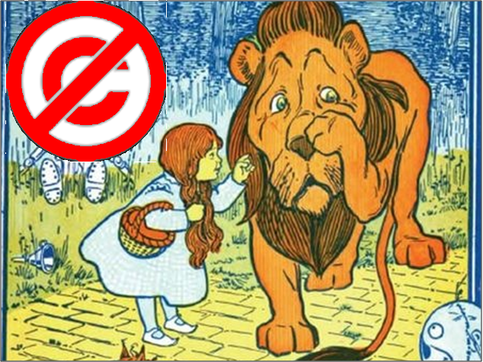
W.W. Denslow, Wizard of Oz
Copyrightable ?
See Hearn v. Meyer, 644 F.Supp. 832 (S.D.N.Y. 1987) (Reproduction of Reproduction: Mere insignificant variations in coloration not alleged to be created intentionally, “mere slavish copies” ). Media file in the public domain.

Slide 11
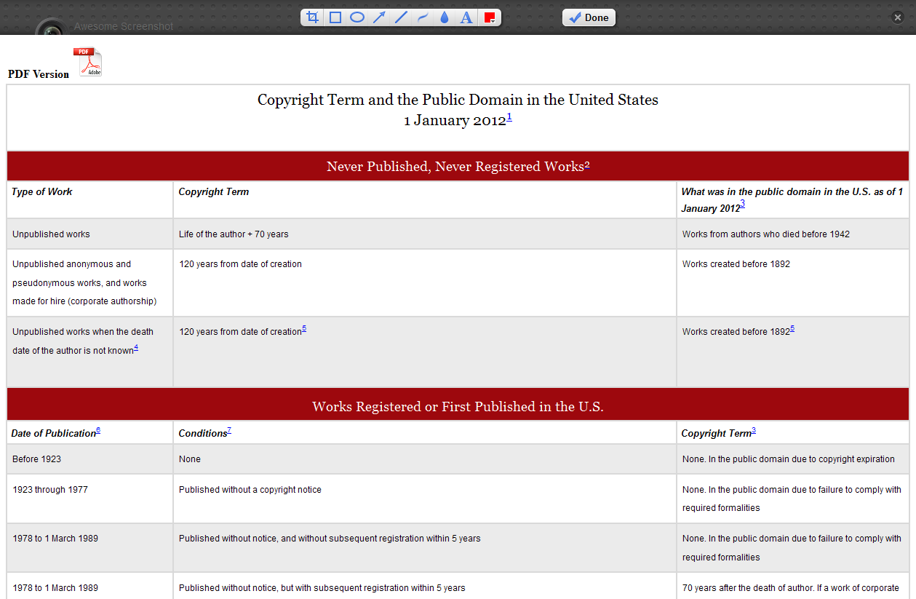
Copyrightable
& not in Public
Domain?
Source: Peter B. Hirtle, Copyright Term and the Public Domain in the United States, 1 January 2010, available at http://www.copyright.cornell.edu/resources/publicdomain.cfm. Licensed under Creative Commons License 3.0 at
http://creativecommons.org/licenses/by-nc/3.0/.

Slide 12
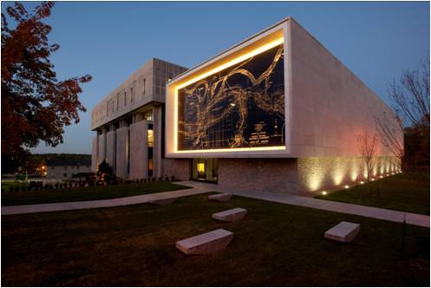
Has a registration been renewed?
Copyrightable
& not in Public
Domain?
Miller Nichols Library Addition
Resource for Re-registration Search, Information about the Catalog of
Entries http://onlinebooks.library.upenn.edu/cce/

Slide 13
Is Use Prohibited under a License?
Copyrightable
& not in Public
Domain?
DMCA
Circumvention?
Is Prohibition
Enforceable?
Fair Use,
Teach Act, or Library
Exemption?
DMCA
Exception?
?
Get
Permission?
?
?
?
?
?
?
?
?
Get
Permission?
Orphan
Work?
Color Key
License
Copyright
DMCA
Yes
No
?
Stop
Go

Slide 14
The Law – Copyright – Library Exemption under § 108
Library and Archives
Exception?
Not just for non-profit libraries. “Libraries within industrial, profitmaking, or proprietary institutions are also eligible for the exemption as long as the reproduction (and distribution) was itself not commercially motivated.” 2-8 Nimmer on Copyright § 8.03
Collection must be open to public
Copy notice requirement

Slide 15
The Law – Copyright – Library Exemption under § 108
Library and Archives
Exception?
Limits
Single copy limit (default rule)
“This does not mean, however, that a single reproduction (and its distribution) exhausts the exemption with respect to the particular work reproduced. Rather, there may be repeated reproduction and distribution ‘of a single copy or phonorecord of the same material on separate occasions.” 2-8 Nimmer on Copyright § 8.03
Three copy limit
Preservation and security (unpublished works). Must own and restrict access.
Replacement of damaged, deteriorating, lost or stolen copy (published works). Must first look for replacement copy at reasonable price and restrict access.

Slide 16
The Law – Copyright – Library Exemption under § 108
Library and Archives
Exception?
CONTU
CONTU is the conference report by National Commission on New Technology Uses of Copyrighted Works and included in the House Report for the 1976 Copyright Act. It addresses 108(g)(2), which
provides that section 108(d)'s exemption for reproduction of entire contributions and articles from collections and periodicals, and small portions of other works, does not extend to situations in which the library or archives “engages in the systematic reproduction or distribution of single or multiple copies or phonorecords of [the] material.” By its terms, however, section 108(g)(2) does not prevent “a library or archives from participating in interlibrary arrangements that do not have … that the library or archives receiving such copies or phonorecords for distribution does so in such aggregate quantities as to substitute for a subscription to or purchase of such work.” Goldstein on Copyright - Goldstein,§7.2.2.1,Reproduction by Libraries and Archives

Slide 17
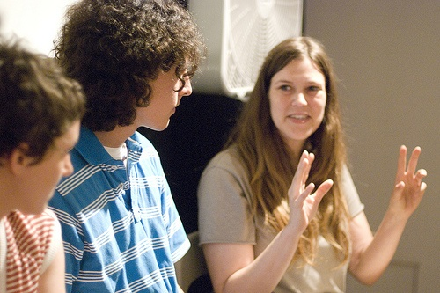
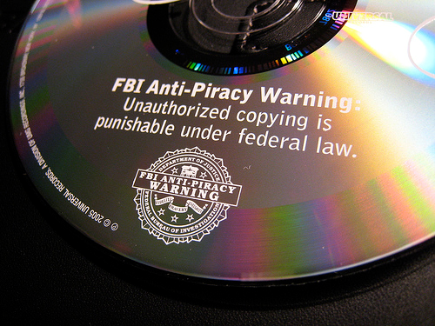
TEACH Act,
Library, or Fair Use
Exception ?
§ 110 & the TEACH Act
In the classroom – Section (1) [Non TEACH ACT]
The following are not infringements of copyright:
(1) performance or display of a work by instructors or pupils in the course of face-to-face teaching activities of a nonprofit educational institution, in a classroom or similar place devoted to instruction,
unless, in the case of a motion picture or other audiovisual work, the performance, or the display of individual images, is given by means of a copy that was not lawfully made under this title, and that the person responsible for the performance knew or had reason to believe was not lawfully made;

Slide 18
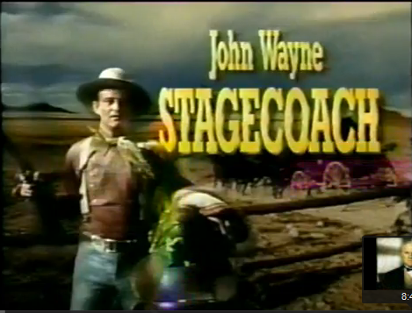
Problem 4
Instructor for distance education class on Film Appreciation wants to stream Stagecoach from a DVD. How would you resolve?
What if she wanted to convert video? What she if wanted to her own use NetFlix subscription?
Solution

Slide 19
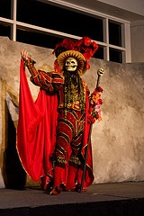
TEACH Act,
Library, or Fair Use
Exception ?
§ 110 & the TEACH Act
Over a Network – Section (2) [TEACH ACT]
The following are not infringements of copyright:
Fundamentally there seem to be but two essential elements for a dramatic composition: (1) that it relate a story, and (2) that it provide directions whereby a substantial portion of the story may be visually or audibly represented to an audience as actually occurring, rather than merely being narrated or described. 1-2 Nimmer on Copyright § 2.06
(2) . . . the performance of a nondramatic literary or musical work
or reasonable and limited portions of any other work,
or display of a work in an amount comparable to that which is typically displayed in the course of a live classroom session , . . .
The key is “actually occurring” dialog!

Slide 20
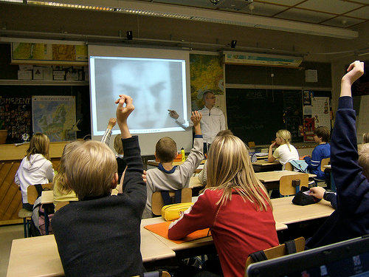
TEACH Act,
Library, or Fair Use
Exception ?
§ 110 & the TEACH Act
Over a Network – Section (2) [TEACH ACT]
The following are not infringements of copyright:
(A) the performance or display is made by, at the direction of, or under the actual supervision of an instructor as an integral part of a class session offered as a regular part of the systematic mediated instructional activities of a governmental body or an accredited nonprofit educational institution;
(B) the performance or display is directly related and of material assistance to the teaching content of the transmission;

Slide 21
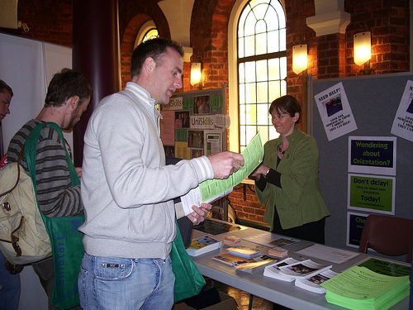
TEACH Act,
Library, or Fair Use
Exception ?
§ 110 & the TEACH Act
Over a Network – Section (2) [TEACH ACT]
(C) the transmission is made solely for, and, to the extent technologically feasible, the reception of such transmission is limited to--
(i) students officially enrolled in the course for which the transmission is made; or
(ii) officers or employees of governmental bodies as a part of their official duties or employment; and

Slide 22
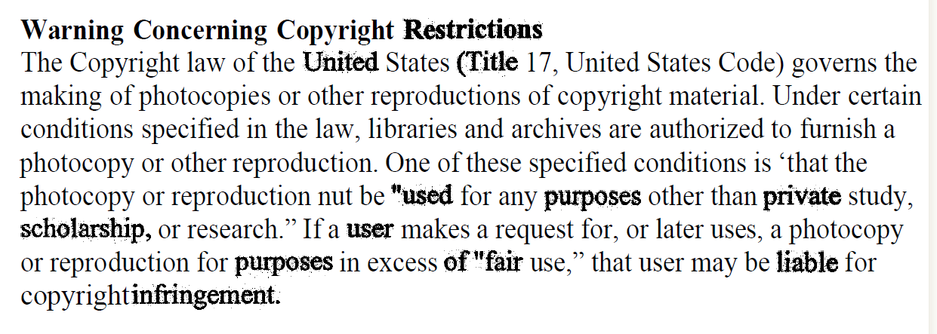
TEACH Act,
Library, or Fair Use
Exception ?
§ 110 & the TEACH Act
Over a Network – Section (2) [TEACH ACT]
(D) the transmitting body or institution -- (i) institutes policies regarding copyright, provides informational materials to faculty, students, and relevant staff members that accurately describe, and promote compliance with, the laws of the United States relating to copyright,
and provides notice to students that materials used in connection with the course may be subject to copyright protection; and

Slide 23
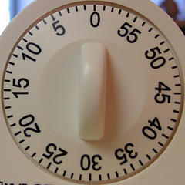
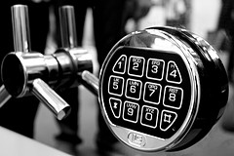
TEACH Act,
Library, or Fair Use
Exception ?
§ 110 & the TEACH Act
Over a Network – Section (2) [TEACH ACT]
(ii) in the case of digital transmissions –
(I) applies technological measures that reasonably prevent-- (aa) retention of the work in accessible form by recipients of the transmission from the transmitting body or institution for longer than the class session; and
(bb) unauthorized further dissemination of the work in accessible form by such recipients to others; and
(II) does not engage in conduct that could reasonably be expected to interfere with technological measures used by copyright owners to prevent such retention or unauthorized further dissemination;
DMCA

Slide 24
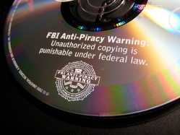
TEACH Act,
Library, or Fair Use
Exception ?
§ 112(f) & the TEACH Act
Transitions and Copies of Digital Works – Paragraph (f)(1)
(1) . . . it is not an infringement of copyright for a governmental body or other nonprofit educational institution entitled under section 110(2)
to transmit a performance or display
to make copies or phonorecords
of a work that is in digital form

Slide 25
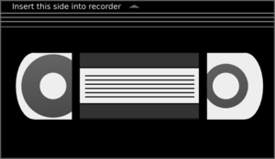
TEACH Act,
Library, or Fair Use
Exception ?
§ 112(f) & the TEACH Act
Transitions and Copies of Digital Works – Paragraph (f)(1) [continued]
and, solely to the extent permitted in paragraph (2), of a work that is in analog form, embodying the performance or display to be used for making transmissions authorized under section 110(2), if--
(A) such copies or phonorecords are retained and used solely by the body or institution that made them, and no further copies or phonorecords are reproduced from them, except as authorized under section 110(2); and
(B) such copies or phonorecords are used solely for transmissions authorized under section 110(2).
?

Slide 26
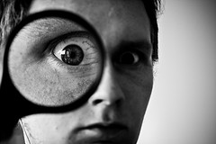
TEACH Act,
Library, or Fair Use
Exception ?
§ 112(f) & the TEACH Act
Transitions and Copies of Digital Works – Paragraph (f)(1) [continued]
(2) This subsection does not authorize the conversion of print or other analog versions of works into digital formats, except that such conversion is permitted hereunder, only with respect to the amount of such works authorized to be performed or displayed under section 110(2) [17 USCS § 110(2)], if--
(A) no digital version of the work is available to the institution; or
(B) the digital version of the work that is available to the institution is subject to technological protection measures that prevent its use for section 110(2).
TPMs

Slide 27
TEACH Act,
Library, or Fair Use
Exception ?
§ 110 & the TEACH Act
In the classroom – Section (1) [Non TEACH ACT]
The following are not infringements of copyright:
(1) performance or display of a work by instructors or pupils in the course of face-to-face teaching activities of a nonprofit educational institution, in a classroom or similar place devoted to instruction,
unless, in the case of a motion picture or other audiovisual work, the performance, or the display of individual images, is given by means of a copy that was not lawfully made under this title, and that the person responsible for the performance knew or had reason to believe was not lawfully made;

Slide 28
Problem 4
Instructor for distance education class on Film Appreciation wants to stream Stagecoach from a DVD. How would you resolve?
What if she wanted to convert video? What she if wanted to her own use NetFlix subscription?
Solution

Slide 29
TEACH Act,
Library, or Fair Use
Exception ?
§ 110 & the TEACH Act
Over a Network – Section (2) [TEACH ACT]
The following are not infringements of copyright:
Fundamentally there seem to be but two essential elements for a dramatic composition: (1) that it relate a story, and (2) that it provide directions whereby a substantial portion of the story may be visually or audibly represented to an audience as actually occurring, rather than merely being narrated or described. 1-2 Nimmer on Copyright § 2.06
(2) . . . the performance of a nondramatic literary or musical work
or reasonable and limited portions of any other work,
or display of a work in an amount comparable to that which is typically displayed in the course of a live classroom session , . . .
The key is “actually occurring” dialog!

Slide 30
TEACH Act,
Library, or Fair Use
Exception ?
§ 110 & the TEACH Act
Over a Network – Section (2) [TEACH ACT]
The following are not infringements of copyright:
(A) the performance or display is made by, at the direction of, or under the actual supervision of an instructor as an integral part of a class session offered as a regular part of the systematic mediated instructional activities of a governmental body or an accredited nonprofit educational institution;
(B) the performance or display is directly related and of material assistance to the teaching content of the transmission;

Slide 31
TEACH Act,
Library, or Fair Use
Exception ?
§ 110 & the TEACH Act
Over a Network – Section (2) [TEACH ACT]
(C) the transmission is made solely for, and, to the extent technologically feasible, the reception of such transmission is limited to--
(i) students officially enrolled in the course for which the transmission is made; or
(ii) officers or employees of governmental bodies as a part of their official duties or employment; and

Slide 32
TEACH Act,
Library, or Fair Use
Exception ?
§ 110 & the TEACH Act
Over a Network – Section (2) [TEACH ACT]
(D) the transmitting body or institution -- (i) institutes policies regarding copyright, provides informational materials to faculty, students, and relevant staff members that accurately describe, and promote compliance with, the laws of the United States relating to copyright,
and provides notice to students that materials used in connection with the course may be subject to copyright protection; and

Slide 33
TEACH Act,
Library, or Fair Use
Exception ?
§ 110 & the TEACH Act
Over a Network – Section (2) [TEACH ACT]
(ii) in the case of digital transmissions –
(I) applies technological measures that reasonably prevent-- (aa) retention of the work in accessible form by recipients of the transmission from the transmitting body or institution for longer than the class session; and
(bb) unauthorized further dissemination of the work in accessible form by such recipients to others; and
(II) does not engage in conduct that could reasonably be expected to interfere with technological measures used by copyright owners to prevent such retention or unauthorized further dissemination;
DMCA

Slide 34
TEACH Act,
Library, or Fair Use
Exception ?
§ 112(f) & the TEACH Act
Transmissions and Copies of Digital Works – Paragraph (f)(1)
(1) . . . it is not an infringement of copyright for a governmental body or other nonprofit educational institution entitled under section 110(2)
to transmit a performance or display
to make copies or phonorecords
of a work that is in digital form

Slide 35
TEACH Act,
Library, or Fair Use
Exception ?
§ 112(f) & the TEACH Act
Transmissions and Copies of Digital Works – Paragraph (f)(1) [continued]
and, solely to the extent permitted in paragraph (2), of a work that is in analog form, embodying the performance or display to be used for making transmissions authorized under section 110(2), if--
(A) such copies or phonorecords are retained and used solely by the body or institution that made them, and no further copies or phonorecords are reproduced from them, except as authorized under section 110(2); and
(B) such copies or phonorecords are used solely for transmissions authorized under section 110(2).
?

Slide 36
TEACH Act,
Library, or Fair Use
Exception ?
§ 112(f) & the TEACH Act
Transmissions and Copies of Digital Works – Paragraph (f)(1) [continued]
(2) This subsection does not authorize the conversion of print or other analog versions of works into digital formats, except that such conversion is permitted hereunder, only with respect to the amount of such works authorized to be performed or displayed under section 110(2) [17 USCS § 110(2)], if--
(A) no digital version of the work is available to the institution; or
(B) the digital version of the work that is available to the institution is subject to technological protection measures that prevent its use for section 110(2).
TPMs

Slide 37
TEACH Act,
Library, or Fair Use
Exception ?
§ 112(b) & the TEACH Act
Transmission Recordings: 30-Day, Seven-Year Rule
(b) Notwithstanding the provisions of section 106, it is not an infringement of copyright for a governmental body or other nonprofit organization entitled to transmit a performance or display of a work, under section 110(2) or under the limitations on exclusive rights in sound recordings specified by section 114(a), to make no more than thirty copies or phonorecords of a particular transmission program embodying the performance or display, if—
(1) no further copies or phonorecords are reproduced from the copies or phonorecords made under this clause; and
(2) except for one copy or phonorecord that may be preserved exclusively for archival purposes, the copies or phonorecords are destroyed within seven years from the date the transmission program was first transmitted to the public.

Slide 38
TEACH Act,
Library, or Fair Use
Exception ?
TEACH Act
Solving the Problem: Recording Stagecoach
For example, if a history professor teaching a digital distance course on the development of the American West wished to show the John Wayne movie Stagecoach to her class, she would face several issues.
Steven A. Armatas, Distance Learning and Copyright: A Guide to Legal Issues, p. 441 (ABA 2008)

Slide 39
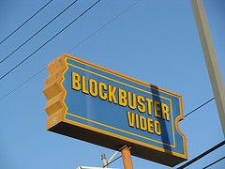
TEACH Act,
Library, or Fair Use
Exception ?
TEACH Act
Problem: Recording Stagecoach
First, the professor could not legally digitize [a] VHS version to use unless, pursuant to the TEACH Act, "no digital version of the work was available to the institution." What does this mean? To what lengths must the professor go to obtain the digital version?
What if the local Blockbuster outlet does not have it?
Must she visit every video store in town?
If that fails, does she have to order it from a distributor or movie studio?
Steven A. Armatas, Distance Learning and Copyright: A Guide to Legal Issues, p. 441 (ABA 2008)

Slide 40
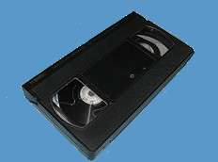
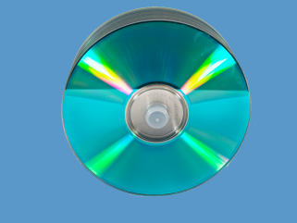
TEACH Act,
Library, or Fair Use
Exception ?
TEACH Act
Problem: Recording Stagecoach
What if Stagecoach had never been released on DVD . . . ?
Our instructor could then use an analog copy (i.e., the videocassette version) and digitize it to show her class.
However, she would be permitted to digitize only the reasonable and limited portion thereof she was allowed to transmit to her students.
Steven A. Armatas, Distance Learning and Copyright: A Guide to Legal Issues, p. 441 (ABA 2008)

Slide 41
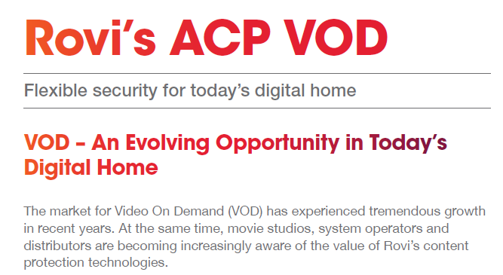
TEACH Act,
Library, or Fair Use
Exception ?
TEACH Act
Problem: Recording Stagecoach
More problematic for the professor is what happens when the analog version is also copyright-protected, such as by the use of "Macrovision [ACP]?"
How can she make the necessary duplicate without violating the TEACH Act's prohibition on interfering with technological protective measures?
Steven A. Armatas, Distance Learning and Copyright: A Guide to Legal Issues, p. 441 (ABA 2008)
Anatomy of a Murder © 1959

Slide 42
The Law – Copyright – Library Exemption under § 108
Library and Archives
Exception?
Not just for non-profit libraries. “Libraries within industrial, profitmaking, or proprietary institutions are also eligible for the exemption as long as the reproduction (and distribution) was itself not commercially motivated.” 2-8 Nimmer on Copyright § 8.03
Collection must be open to public
Copy notice requirement

Slide 43
The Law – Copyright – Library Exemption under § 108
Library and Archives
Exception?
Limits
Single copy limit (default rule)
“This does not mean, however, that a single reproduction (and its distribution) exhausts the exemption with respect to the particular work reproduced. Rather, there may be repeated reproduction and distribution ‘of a single copy or phonorecord of the same material on separate occasions.” 2-8 Nimmer on Copyright § 8.03
Three copy limit
Preservation and security (unpublished works). Must own and restrict access.
Replacement of damaged, deteriorating, lost or stolen copy (published works). Must first look for replacement copy at reasonable price and restrict access.

Slide 44
The Law – Copyright – Library Exemption under § 108
Library and Archives
Exception?
CONTU
CONTU is the conference report by National Commission on New Technology Uses of Copyrighted Works and included in the House Report for the 1976 Copyright Act. It addresses 108(g)(2), which
provides that section 108(d)'s exemption for reproduction of entire contributions and articles from collections and periodicals, and small portions of other works, does not extend to situations in which the library or archives “engages in the systematic reproduction or distribution of single or multiple copies or phonorecords of [the] material.” By its terms, however, section 108(g)(2) does not prevent “a library or archives from participating in interlibrary arrangements that do not have … that the library or archives receiving such copies or phonorecords for distribution does so in such aggregate quantities as to substitute for a subscription to or purchase of such work.” Goldstein on Copyright - Goldstein,§7.2.2.1,Reproduction by Libraries and Archives

Slide 45
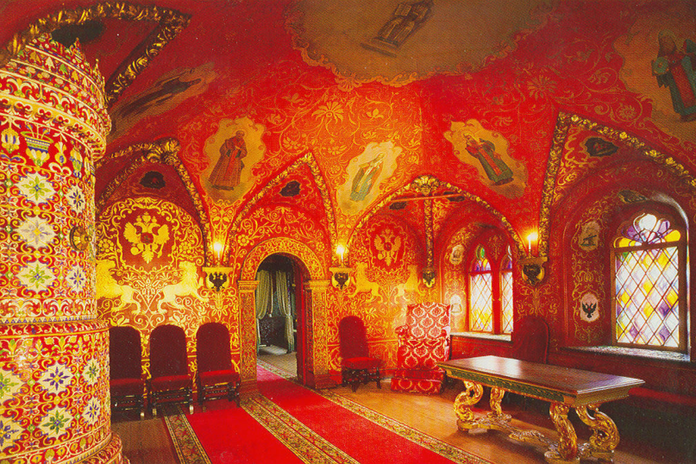
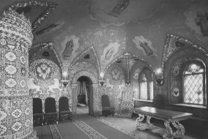
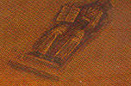
Problem 5
Graduate student theses from the fine arts are being loaded into the library’s digital repository.
Can university include images of student works that are copies of other famous artists?
Would it matter if the instructor, as a precaution, always had the students change 20 things in a reproduction of a painting?
What if the images were simply image scans at a very low resolution, black and white, of a selected portion and of a poor quality?

Slide 46
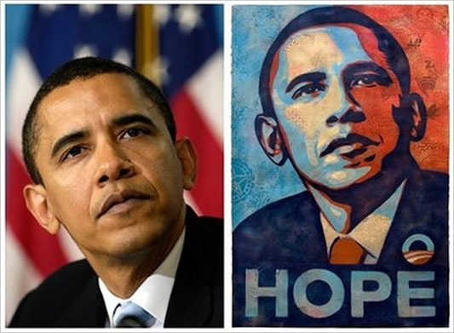
AP (Mannie Garcia) v. Shepard Fairey
Fair Use?
?

Slide 47
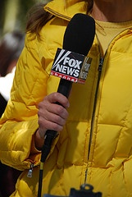
Fair Use
TEACH Act,
Library, or Fair Use
Exception ?
17 U.S. Code § 107
The fair use of a copyrighted work, including such use by reproduction in copies . . . for purposes such as criticism, comment, news reporting, teaching (including multiple copies for classroom use), scholarship, or research, is not an infringement of copyright. In determining whether the use made of a work in any particular case is a fair use the factors to be considered shall include –

Slide 48
Fair Use
TEACH Act,
Library, or Fair Use
Exception ?
The central purpose of this inquiry is to determine whether and to what extent the new work is "transformative." Campbell, 510 U.S. at 579. A work is "transformative" when the new work does not "merely supersede the objects of the original creation" but rather "adds something new, with a further purpose or different character, altering the first with new expression, meaning, or message." Id. Perfect 10, Inc. v. Amazon.com, Inc., 508 F.3d 1146, 1164 (9th Cir. Cal. 2007)
(1) the purpose and character of the use, including whether such use is of a commercial nature or is for nonprofit educational purposes;

Slide 49
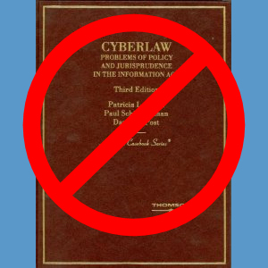
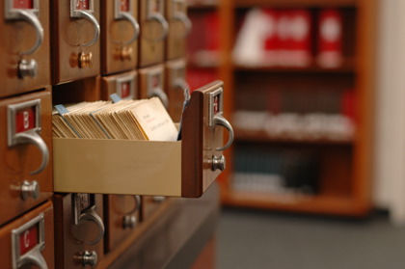
Fair Use
TEACH Act,
Library, or Fair Use
Exception ?
informational
or functional v.
creative
(2) the nature of the copyrighted work;
(3) the amount and substantiality of the portion used in relation to the copyrighted work as a whole; and
(4) the effect of the use upon the potential market for or value of the copyrighted work.
published v.
not published
$
Notes:
Functional – e.g. a catalog or index (a “work more of diligence than originality or inventiveness”
Not published: (1) out of print (however, some courts rule that out-of-print works are more valuable to author since the only fee they get is from permissions and (2) confidentially held works

Slide 50
Derivative & Transformative Works
Fair Use

Slide 51
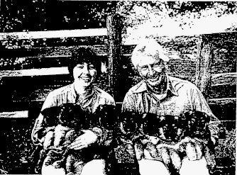
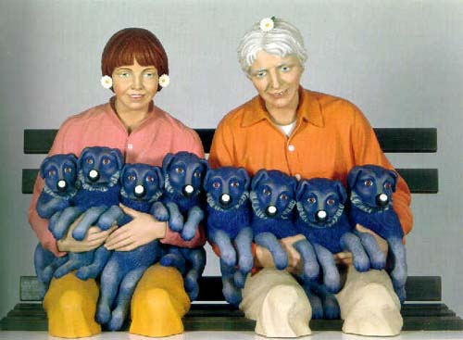
Rogers v. Koons, 960 F.2d 301 C.A.2 (N.Y.),1992
Fair Use?
Rejected!
Another Link

Slide 52
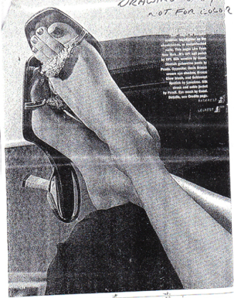
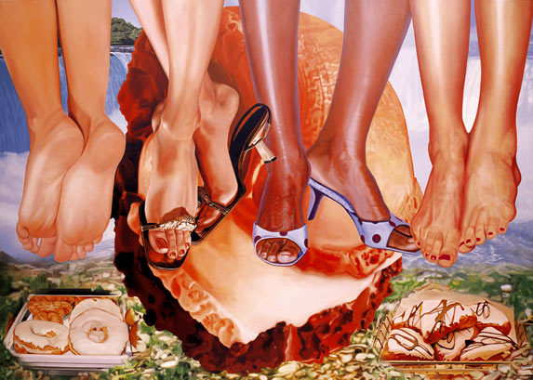
Blanch v. Koons, 467 F.3d 244, C.A.2 (N.Y.), 2006
Fair Use?
OK!

Slide 53
Gaylord v. U.S.
Fair Use?
85 Fed. Claims Ct. 59 (2008)
595 F. 3d 1364 (Fed. Cir. 2010)

Slide 54
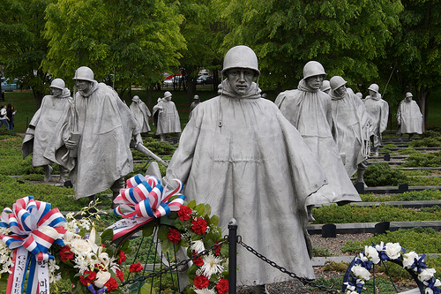
Fair Use
Attribution: Tracy Lee Carroll (aka StarrGazr ), Korean War Memorial,
at http://www.flickr.com/photos/tracylee/137006271/ .
http://creativecommons.org/licenses/by-nc-nd/2.0/deed.en

Slide 55
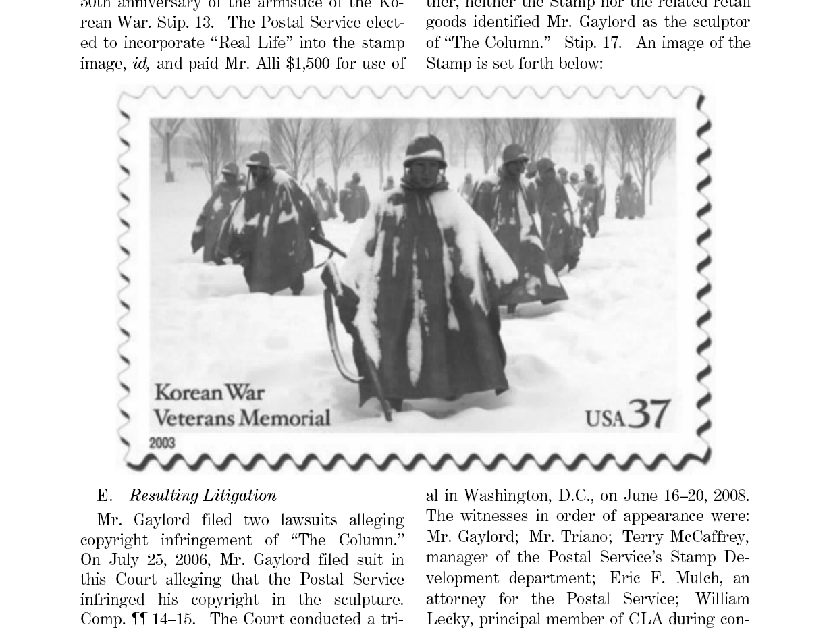
Fair Use?
Not Fair Use
Changing the appearance of a work without changing the character and purpose of the work (honoring soldiers) is not transformative and thus fair use.

Slide 56
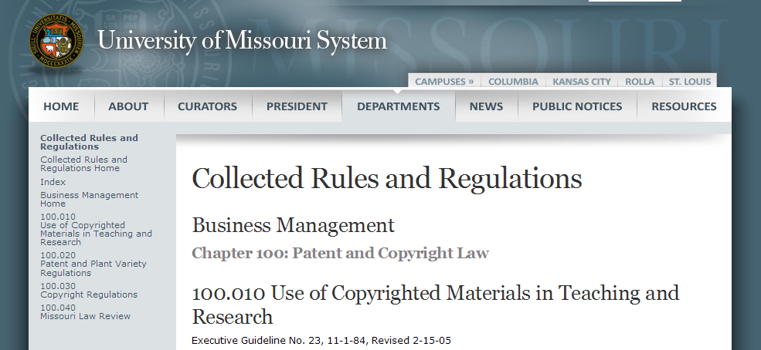
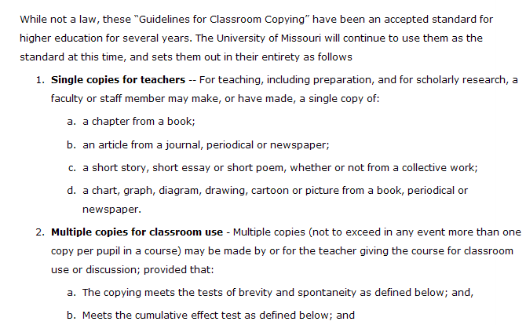
Fair Use, University Regulations & the Guidelines for Classroom Copying
TEACH Act,
Library, or Fair Use
Exception ?

Slide 57
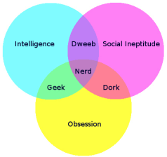
Classroom Guidelines
Brevity
(i) Poetry: (a) A complete poem if less than 250 words and if printed on not more than two pages or, (b) from a longer poem, an excerpt of not more than 250 words.
(ii) Prose: (a) Either a complete article, story or essay of less than 2,500 words, or (b) an excerpt from any prose work of not more than 1,000 words or 10% of the work, whichever is less, but in any event a minimum of 500 words.
(iii) Illustration: one chart, graph, diagram, drawing, cartoon or picture per book or per periodical issue.
Click for attribution
Click for attribution
Click for Attribution and Licensingn

Slide 58
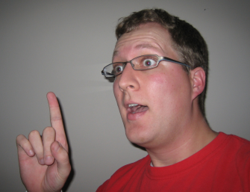
Classroom Guidelines
Spontaneity
(i)The copying is at the instance and inspiration of the individual teacher, and
(ii) The inspiration and decision to use the work and the moment of its use for maximum teaching effectiveness are so close in time that it would be unreasonable to expect a timely reply to a request for permission.
Cumulative Effect
(i) The copying of the material is for only one course in the school in which the copies are made.
(ii) Not more than one short poem, article, story, essay or two excerpts may be copied from the same author, nor more than three from the same collective work or periodical volume during one class term.
(iii) There shall not be more than nine instances of such multiple copying for one course during one class term.
Eureka! Click for attribution
& License
119

Slide 59
Classroom Guidelines
Many universities no longer use.
Duke http://library.duke.edu/about/depts/scholcomm/copyright-and-fair-use.pdf
University of California ♦♦♦ http://www.universityofcalifornia.edu/copyright/fairuse.html
Georgia State http://www.usg.edu/copyright
Plaintiffs seek to enforce in Georgia State Case.
See also ALA Copyright Articles, Daniel Lee, Fair Use and Guidelines, ALA.

Slide 60
Georgia State - Impact desired by plaintiff
Proposed injunction
Define fair use by Classroom Copying Guidelines
Lesser of 10% or 1000 words
Limit fair use in any case to only 10% of course readings
90% must be purchased by students or licensed
Student copyright fee?
How would Annual Campus License work?
Give publishers access to LMS sites

Slide 61
Georgia State
Rejected Classroom Guidelines as Law, however
Ten percent of a work was acceptable as fair use if the book had fewer than 10 chapters
A single chapter was considered fair use for books that contained 10 or more chapters
As little as 3% of a work was considered too much for fair use in a situation where the work was long and had many chapters
Percentages should be calculated based on the total number of pages in the book
Individual chapters by different authors in an edited volume should by counted by the same method and not as if each were an individual work
Rejected the “subsequent semester” rule (might be able to use the same material more than once)
Kevin Smith, More on GSU and the publisher response, http://blogs.library.duke.edu/scholcomm/2012/05/22/more-on-gsu-and-the-publisher-response
Kevin Smith, The GSU decision — not an easy road for anyone, http://blogs.library.duke.edu/scholcomm/2012/05/12/the-gsu-decision-not-an-easy-road-for-anyone

Slide 62
Georgia State
Was the heart of the work used?
Was there a “readily available” license for reproduction of the excerpt in digital form?
Were licensing fees an important part of the value of the original work in question?
Usually not the case
When license not available, the amount of the work used is less valuable
GSU policy based upon faculty completing a checklist was in “good faith”; however, criticized because failed to …
Provide percentage limit
Give guidance about market harm
Kevin Smith, More on GSU and the publisher response, http://blogs.library.duke.edu/scholcomm/2012/05/22/more-on-gsu-and-the-publisher-response
Kevin Smith, The GSU decision — not an easy road for anyone, http://blogs.library.duke.edu/scholcomm/2012/05/12/the-gsu-decision-not-an-easy-road-for-anyone

Slide 63
Georgia State
“This decision is not, in my opinion anyway, a cause for large-sale or precipitous changes at most institutions”
Kevin Smith, More on GSU and the publisher response, http://blogs.library.duke.edu/scholcomm/2012/05/22/more-on-gsu-and-the-publisher-response

