Slide 1
Librarians as University Copyright & Licensing Problem Solvers
Paul D. Callister, JD, MSLIS
Director of the Leon E. Bloch Law Library &
Professor of Law
Email callisterp@umkc.edu
http://www1.law.umkc.edu/faculty/callister/presentations/librarians_as_copyright_problem_solvers.pptx
© 2012, Paul D. Callister. This work is licensed under a Creative Commons Attribution-NoDerivs 2.5 License. Attribution and licensing information for images and sound effects follow this presentation.

Slide 2
THE FOLLOWING PRESENTATION IS FOR DISCUSIONAL PURPOSES ONLY AND SHOULD NOT BE CONSTRUED AS OR REPLACE THE NEED FOR OBTAINING LEGAL ADVICE. YOU SHOULD CONSULT AN ATTORNEY.

Slide 3
Workshop Description
This session will
initiate participants into the complex problems copyright and licensing issues facing university faculty and librarians,
train attendees in techniques for resolving those problems, and
outline a program that the librarians at the University of Missouri-Kansas City have developed to support IS and faculty who have copyright issues in the classroom.

Slide 4
Part I
The Framework

Slide 5
Part II
First Stop - Licensing

Slide 6
Part III
Traditional Copyright

Slide 7
Part IV
DMCA

Slide 8
Part V
Orphan Works

Slide 9
Copyright & Distance Education Resources
AALL Licensing Principles for Electronic Resources , http://www.aallnet.org/committee/reports/LicensingPrinciplesElecResources.pdf
♦♦♦ Stephen A. Armatas, Distance Learning and Copyright: A Guide to Legal Issues (ABA 2008)
♦♦ Le Beau, UMKC LibGuides: Copyright , http://libguides.library.umkc.edu/copyright
Copyright Clearance Center, http://www.copyright.com/
Creative Commons Search, http://search.creativecommons.org/
Guidelines for Classroom Copying of Books and Periodicals, http://www.utsystem.edu/ogc/intellectualproperty/clasguid.htm
Guidelines for Educational Uses of Music, http://www.utsystem.edu/ogc/intellectualproperty/musguid.htm

Slide 10
Additional Copyright & Distance Education Resources
♦ United States Copyright Office, Reproduction of Copyrighted Works by Educators and Librarians, http://www.copyright.gov/circs/circ21.pdf
♦ University of Missouri System, Collected Rules & Regulations, 100.010 Use of Copyrighted Materials in Teaching and Research, http://www.umsystem.edu/ums/departments/gc/rules/business/100/010.shtml
♦ University of Missouri System, Rules and Resources for Online Intellectual Property, http://www.umsystem.edu/ums/departments/is/ip/rules.shtml
♦♦ University of Texas, Crash Course in Copyright , http://www.utsystem.edu/OGC/IntellectualProperty/cprtindx.htm
Yale University Library, Licensing Digital Information: A Resource for Librarians, http://www.library.yale.edu/%7Ellicense/

Slide 11
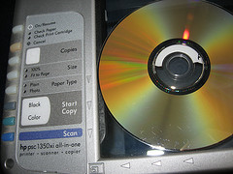








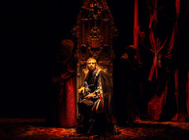
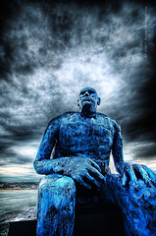
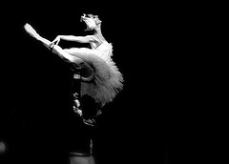
Attributions & Licensing
Click image to link to source
Click license icon for terms
Brian Herzog, Copying a DVD1
Len Radin, Emily as Mime in “Check Please”
Joel Telling, for-rent-sign
Rodrigo Müller, make some icon every day #308
Book design by Amanda Dewy,
© 2007, all rights reserved ATSS Publications
Brent Danley, Picture in Picture
Antonio Edward, Musical+notes
Travis Nep Smith, Man With a Skull Tattoo Back
FunKa-Lerele, Hamlet,
Christopher Chan, Sculpture by the Sea 2007
Ramon, Ballet Nacio de Cuba

Slide 12
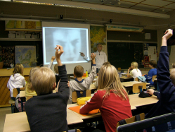
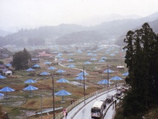
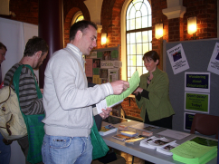


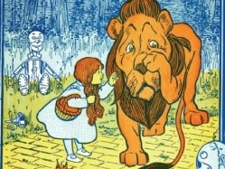
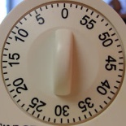
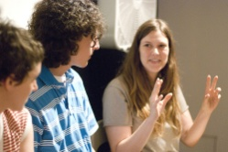
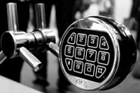

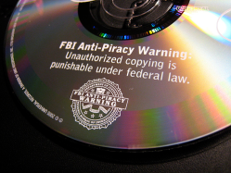
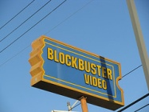
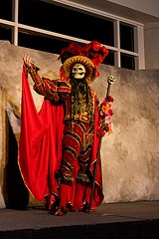
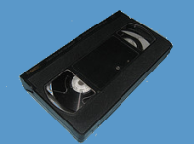

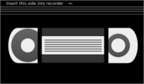


Attributions & Licensing
Click image to link to source
Click license icon for terms
Juska Wendland, Project 365, day 40 – 22.11.2006
Dddeco, 1991 Umbrella Project (Japan)
uwa_studentservices, Mid-year enrolments 2009
W.W. Denslow, Wizard of Oz (1900) (in public domain)
Lynda Giddens, Kitchen Timer
Source: Electronic Text Center, University of Virginia Library
Uniondocs, 6/6 Florida Experimental Film/Video Festival: Spacey Space
Scott Witt, electronic safe
Okko Pyykkö, Day 174
Bizmac, FBI Anti-Piracy Warning!
Colin, blockbuster video
Howie Muzika, San Diego Comic- Con 2009 MASQUERADE
Zimperfish, Video cassette
Video Tape
Creative Commons License 3.0

Slide 13




Attributions & Licensing
Click image to link to source
Click license icon for terms
Rob Davies, CDs DVDs on White Background
Steve Rhodes, Fox News “reporter” – San Francisco Olympic Torch
IRRI Images, Irri Library
A-birdie, Confused

Slide 14
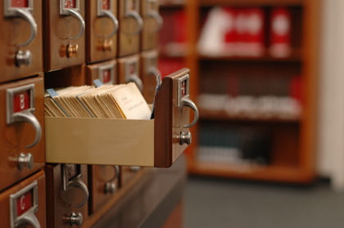



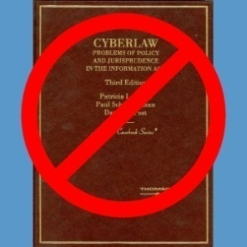


Attributions & Licensing
Click image to link to source
Click license icon for terms
Sound Effects
Bikebell2.wav, by RoofDog
buzzer1.wav, by www.wyomingwebdesign.com (free sounds)
MouthPop.wav, by HerbertBoland
bank_stamp_2.wav, by Robinhood76
typewriter.wav, by Horn
Photo by Gregg
Taran Rampersad, Scale of Justice
Based upon book image for Patricia L. Bella, Paul Schiff Berman, & David G. Post Cyberlaw: Problems of Policy and Jurisprudence in the Information Age (2006)
Penny Gentieu,
Claimed as fair use.
used for purposes
of comment and
criticism
A-birdie, Confused
Tv Studio Camera

Slide 15
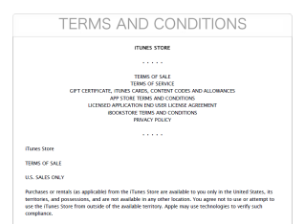
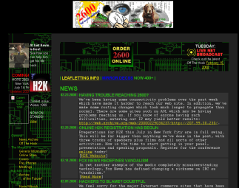

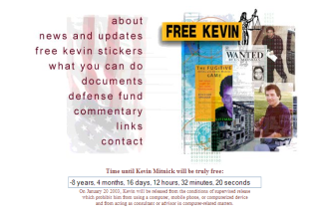
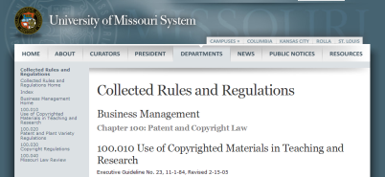
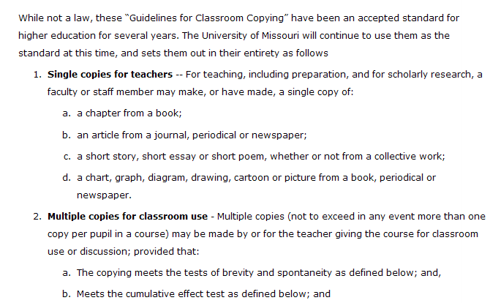
Screenshots and Images Produced by this Author
Click image to link to source
Screenshot of iTunes license from PDF document (Aug. 11, 2010).
Screenshot from www.2600.com via web.archive.org (Feb. 29, 2000)
Screen shot originally taken from web site of backupanydvd.com, which has since changed.
Screen shot from web.archive.org (Nov. 5, 2000).
Screen shots from University of Missouri System Collected Rules and Regulations

Slide 16
The End

