Slide 1
Metacognition: The Transformation from Novice to Expert
Paul D. Callister, JD, MSLIS
Library Director &
Professor of Law
Email callisterp@umkc.edu
Michael Robak, JD, MSLIS
Associate Library Director &
Director of Technologies
Email robakm@umkc.edu
© 2012, Paul D. Callister. This work is licensed under a Creative Commons Attribution-NoDerivs 2.5 License. Attribution and licensing information for images and sound effects follow this presentation.

Slide 2
It’s about expertise.

Slide 3
Metacognition
“Thinking about thinking”
Idealized notions and predictions of performance
Self-monitoring of learning
“Regulating experience”
Intentional learning
Behavioral modification
Interrupts other cognitive behaviors
Cognitive strategies
Comparison of self against experts
Reflexivity of information processing
Awareness and assessment of cognitive structures, schemata, heuristics, etc.
Pathway to intuition
Capacity for lifelong learning
Notes:
(1) “rehearsal strategies,” (2) “elaboration strategies,” (3) “organizational strategies,” (4) “comprehensive monitoring strategies . . . sometimes referred to as metacognition,” and (5) “affective strategies.”

Slide 4
Borrowing from Medical Education
“The underlying thought process of experts that enables them to learn from experience and ultimately to act on intuition.”
MARK QUIRK, INTUITION AND METACOGNITION IN MEDICAL EDUCATION: KEYS TO DEVELOPING EXPERTISE, xviii (2006).

Slide 5
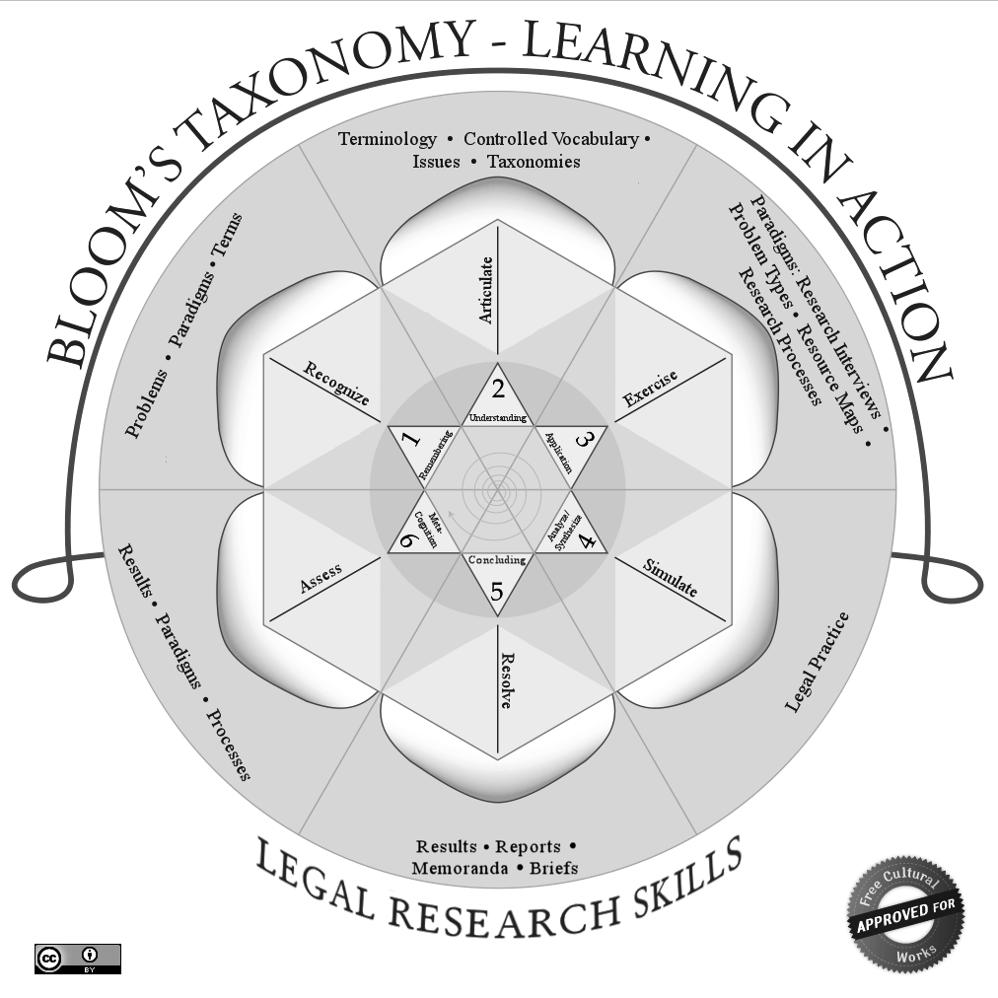

Slide 6
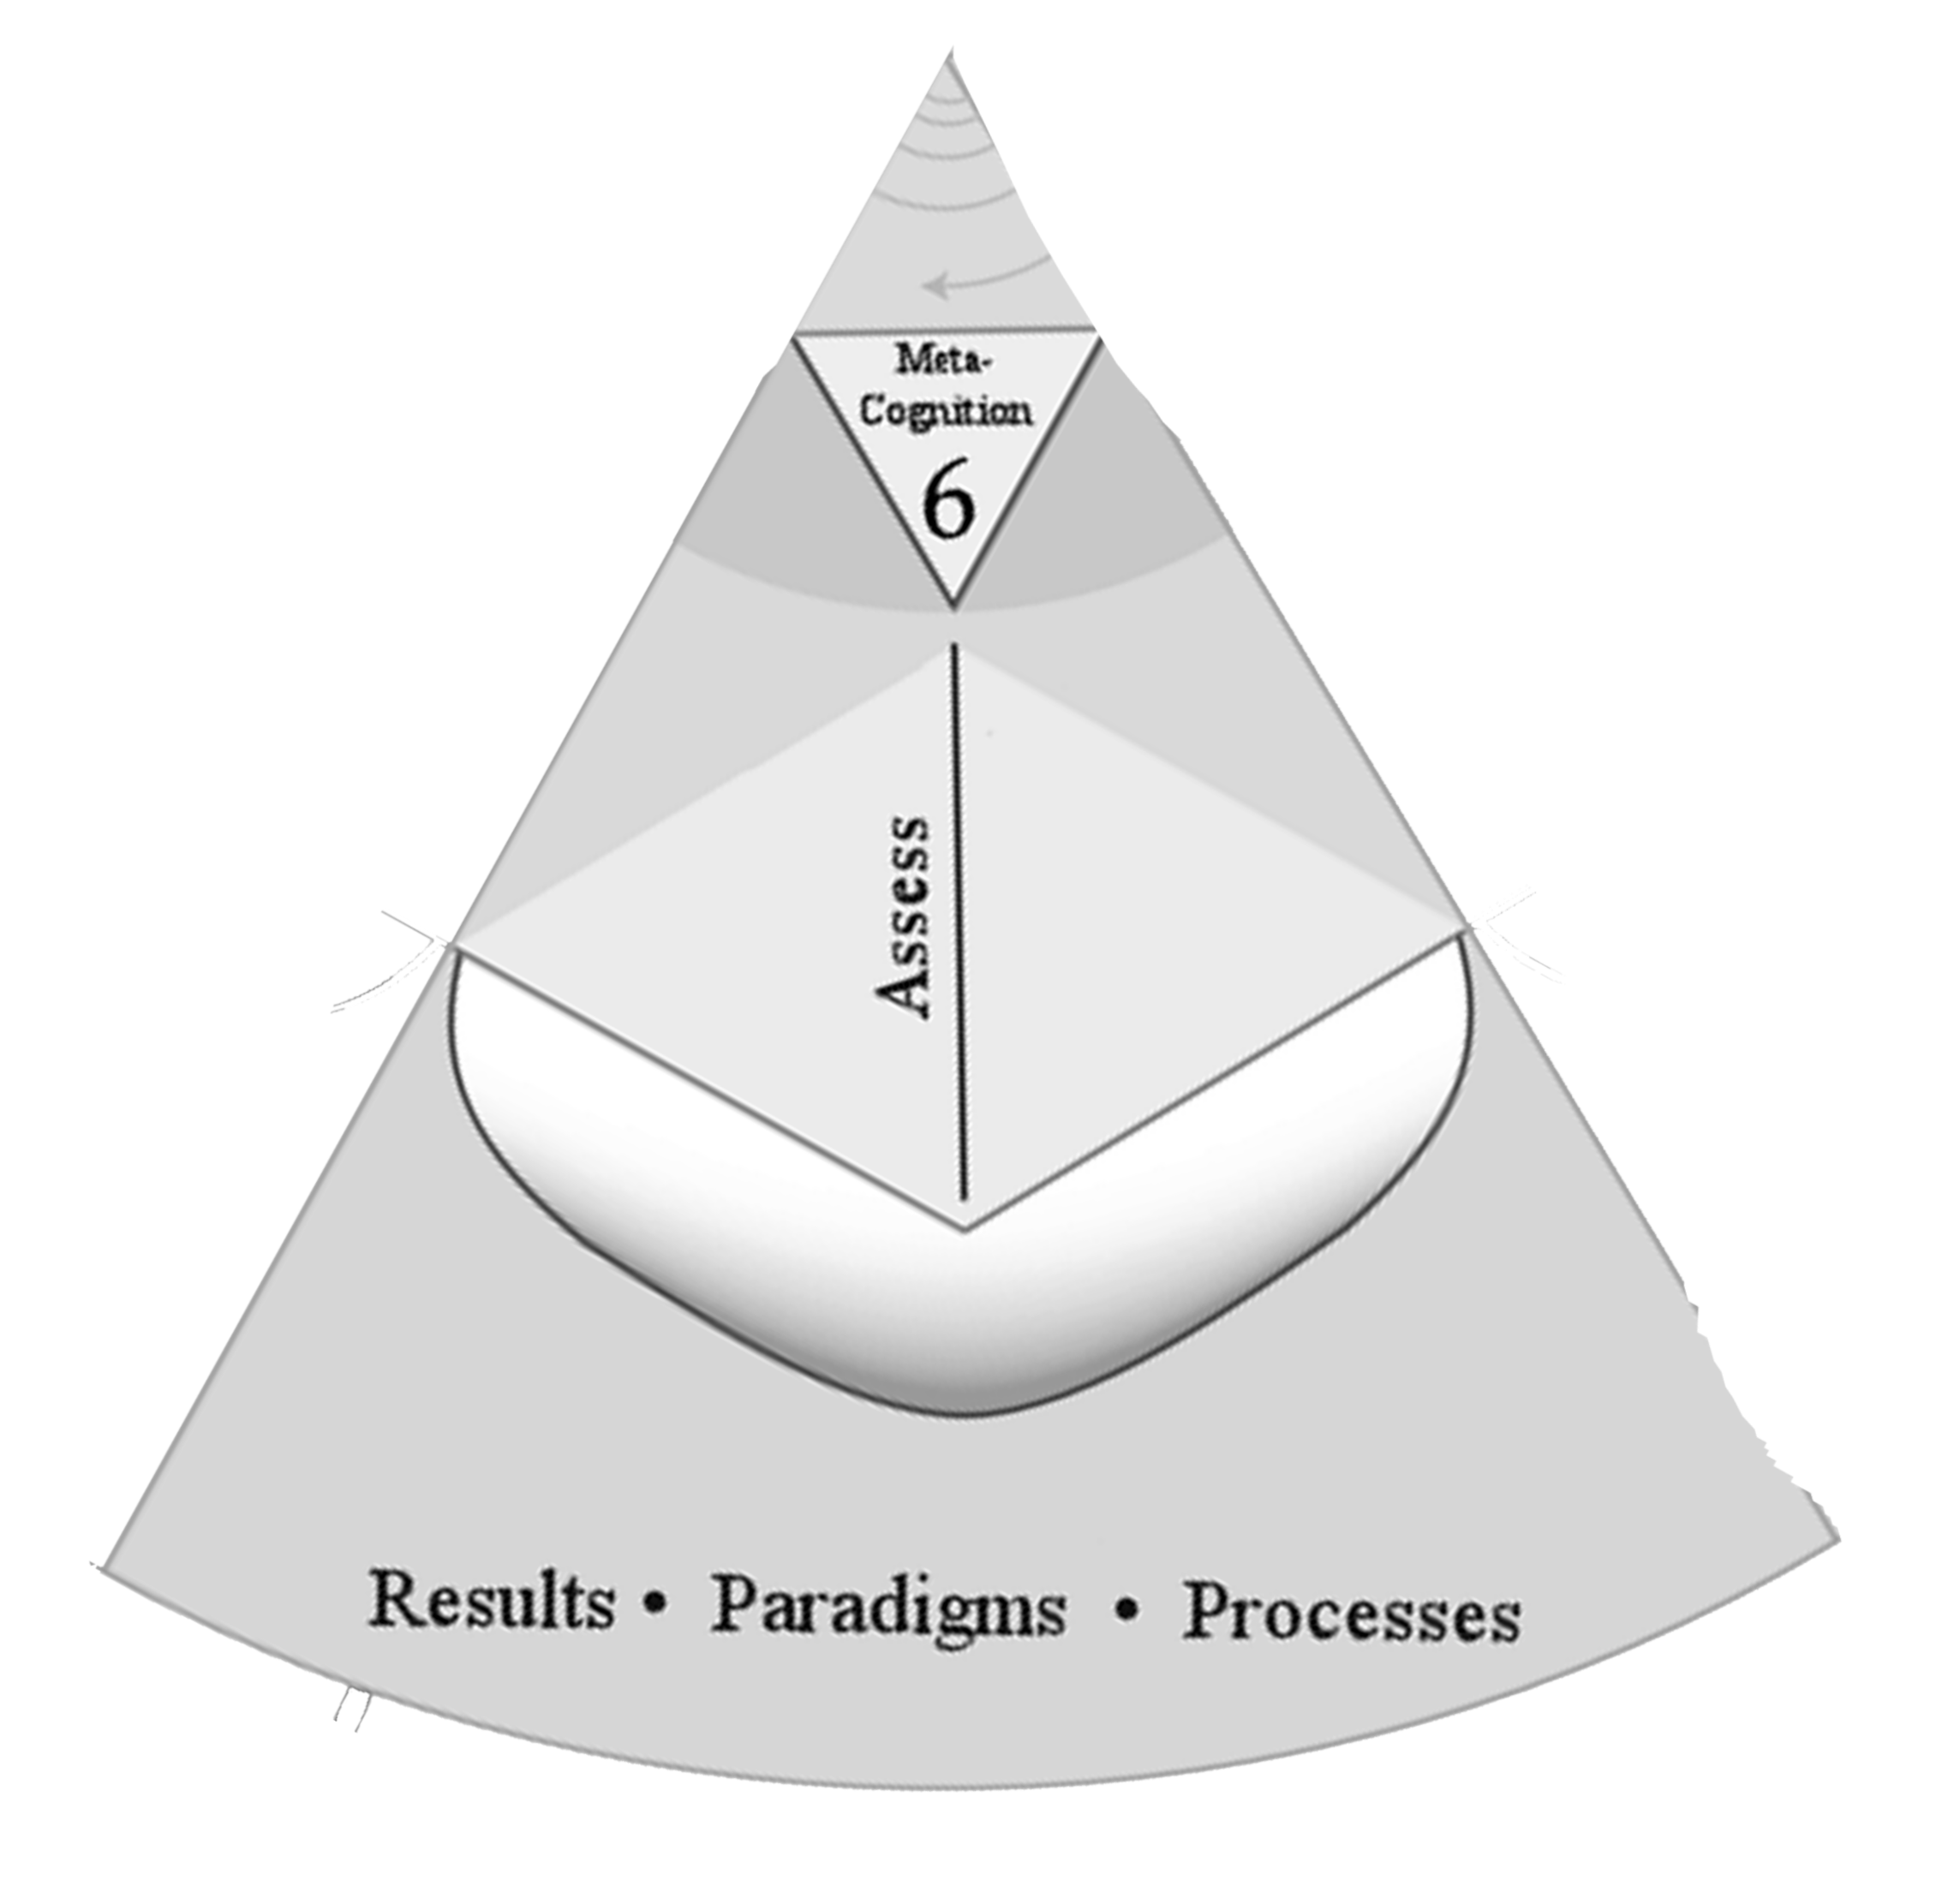

Slide 7
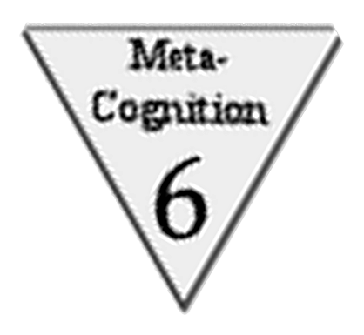

Slide 8
Beginning Tax Problem
You represent a non-profit group of evangelical Christian churches that in general are dedicated to providing service to the community through activities such food kitchens and homeless shelters.
They wish to sponsor a state constitutional amendment opposing same-sex marriage but are concerned about whether this will adversely affect their non-profit status. What do you advise?

Slide 9
Student Answer
Analysis:
The church would lose their tax exempt status by engaging in lobbying that attempts to influence legislation related to same-sex marriage
Rule: D- 4104.
Requirements for tax-exempt status
“Foundations having religious… purposes… are tax-exempt if no substantial part of the organization’s activities consist of propaganda or otherwise attempting to influence legislation.”

Slide 10
Evaluation of Student
Answer fails to get to the real question: What is substantial?

Slide 11
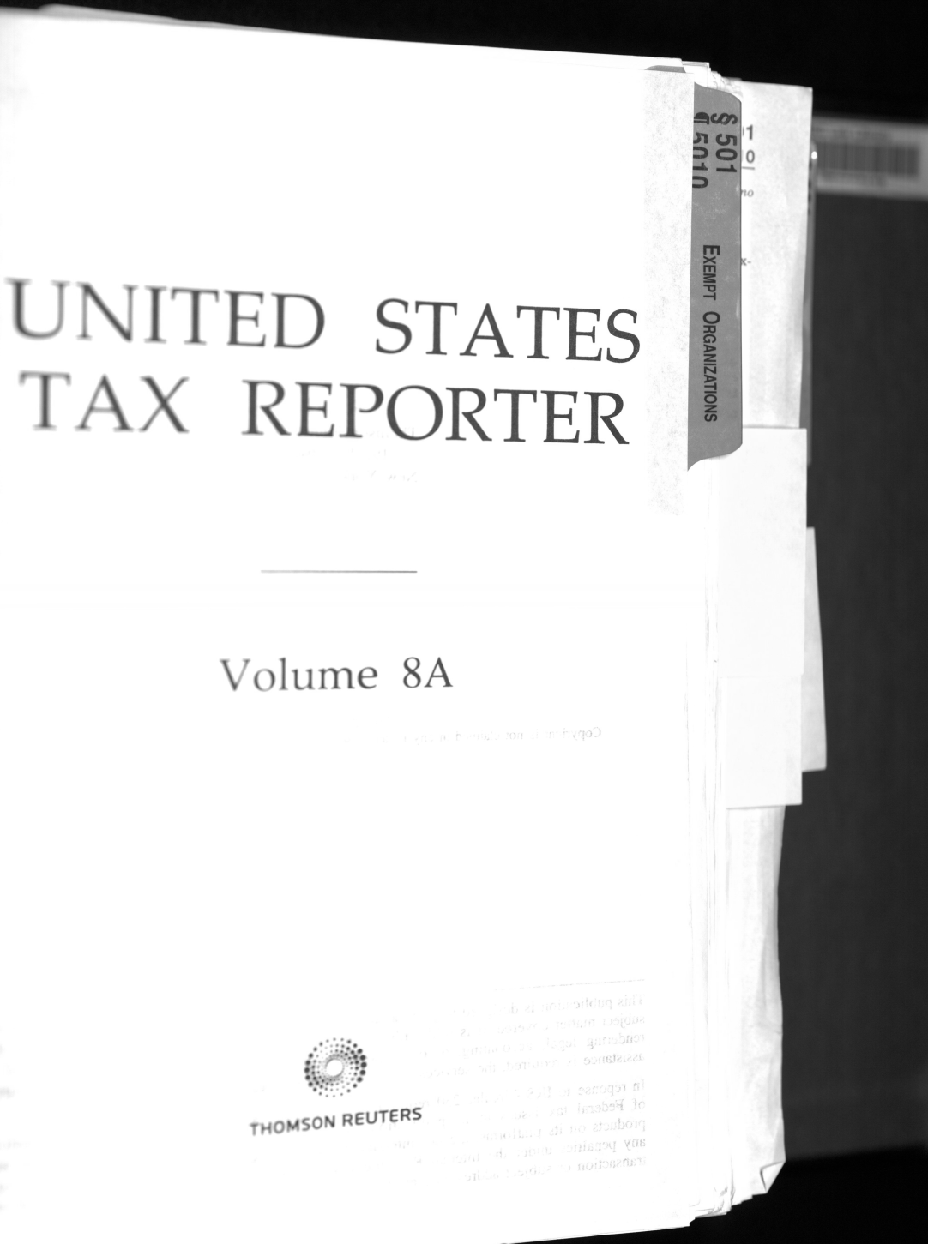
Bring in the Expert!

Slide 12
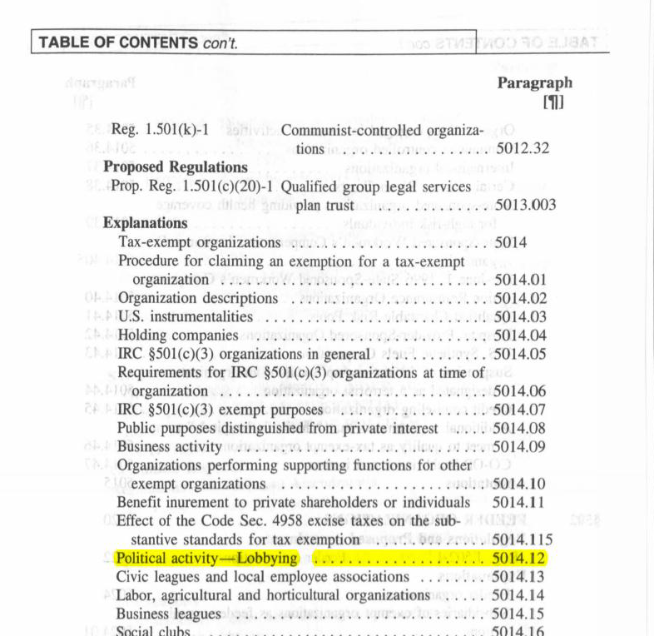

Slide 13
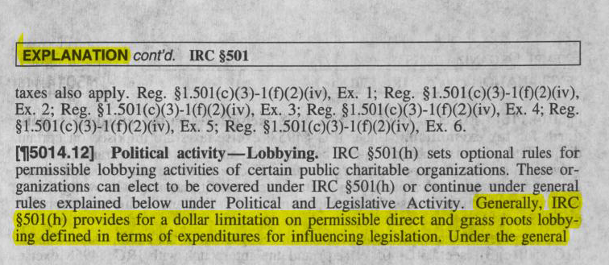

Slide 14
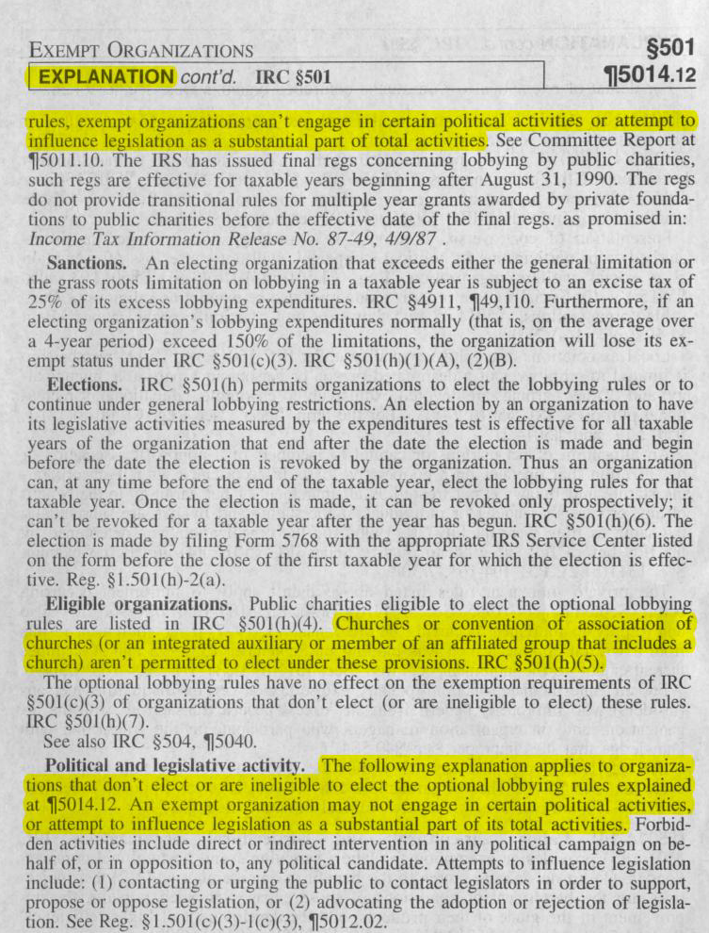

Slide 15
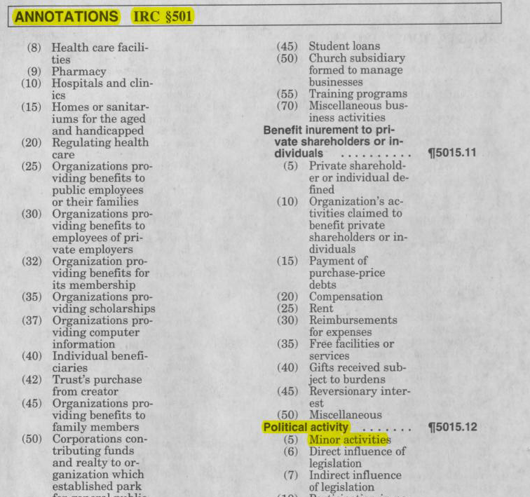

Slide 16
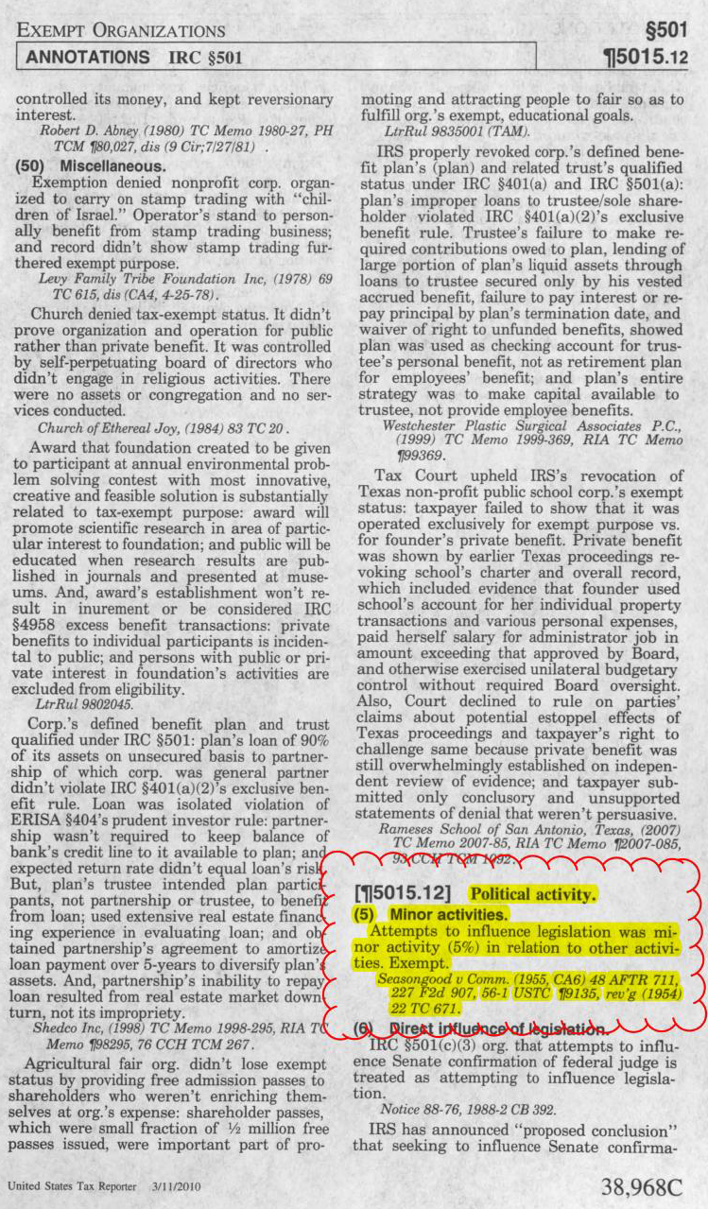
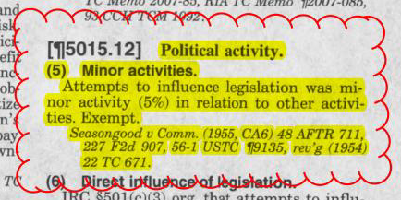

Slide 17
And now a moment for metacognition . . . .

Slide 18
Why did the search fail?

Slide 19
ACRL Standards, Performance
Indicators, and Outcomes
Standard One
The information literate student determines the nature and extent of the information needed.
Source: http://www.ala.org/acrl/standards/informationliteracycompetency#stan

Slide 20
Draft Law School Information Literacy Standards
Standard IV: Apply information effectively to resolve a specific issue or need.
4. Know when to conduct more research to better resolve a specific issue or need.
Source: Kim-Prieto, Dennis, The Road Not Yet Taken: How Law Student Information Literacy Standards Address Identified Issues in Legal Research Education and Training 103 Law Libr. J. 605, 624 (2011).

Slide 21
Draft Law School Information Literacy Standards
Examples of behaviors that indicate mastery:
a. Reflecting on the successes or failures of prior strategies for integrating new information into the analysis.
b. Recognizing when specific questions within a larger research problem have not been answered with the information compiled.
c. Recognizing when the ultimate questions presented have not been fully answered through the research already obtained.
d. Recognizing when sufficient research has been done to adequately address the legal issue or information need.
Id. at 613.

Slide 22
Boulder Statement on Legal Research Education (2009)
Students will experience a cognitive apprenticeship by learning the importance of understanding the legal system in which their question arises and evaluating available legal resources. Through this apprenticeship the student will synthesize information about legal systems and resources to identify the best research plan for a given question. The students will also learn to continually re-evaluate their progress and results to arrive at the optimal answer to the legal problem.
Source: http://www.utexas.edu/law/faculty/pubs/bb26663_pub.pdf

Slide 23
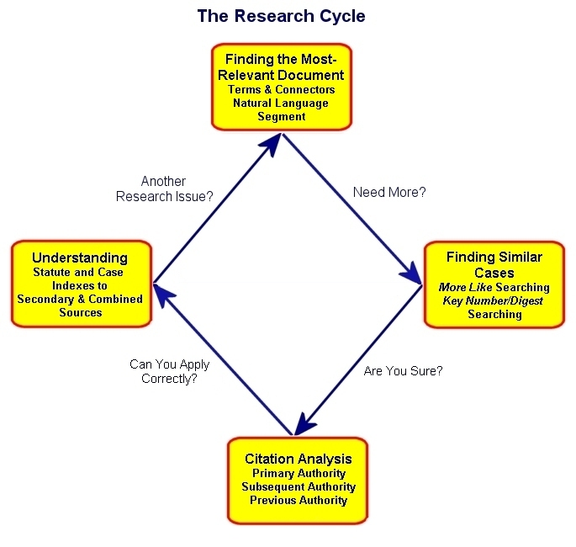
Failure to recognize the reiterative process of a schemata or learning strategy.

Slide 24
Build a better construct to accommodate legislative history, rulemaking, etc.

Slide 25
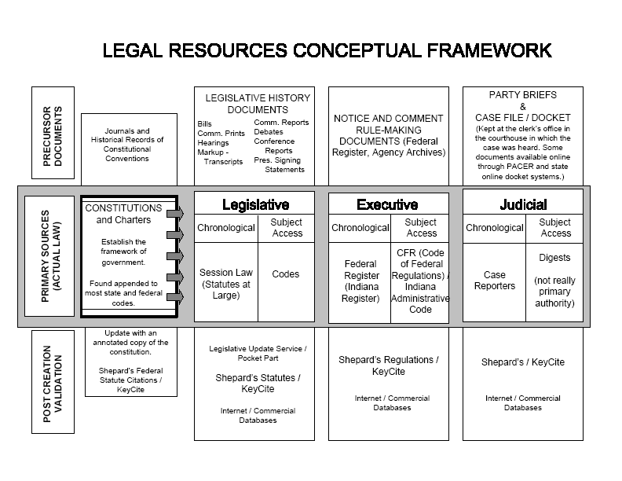
Peter A. Hook, Creating an Online Tutorial and Pathfinder, 94
LAW LIBR. J. 243 (2002)

Slide 26
The End

