Slide 1
Why the Boulder Conference on Legal Information: Scholarship and Teaching?
Paul D. Callister, JD, MSLIS
Director of the Leon E. Bloch Law Library &
Professor of Law
University of Missouri-Kansas City

Slide 2

Reasons
Improve scholarship among aspiring scholars in the profession
Address Carnegie Report’s failure to mention libraries and legal research
Develop pedagogy

Slide 3
http://lawlibrary.colorado.edu/boulder-conferences-legal-research-education
- OR -
Just GOOGLE
It!

Slide 4

Carnegie - About Apprenticeships and Signature Pedagogies

Slide 5
Apprenticeships
Carnegie names three:
  Cognitive
  Practice Situations
  Identity (“Social Ethical”)
Boulder finds room for legal research instruction in all three
Notes:
Why is it cognitive? Because we have to “synthesize information about legal systems and resources to identify the best best research plan for a given condition.

Slide 6
What is Our Signature Pedagogy?

Slide 7

Signature Pedagogies
Surface
Deep
Tacit
Shadow

Slide 8
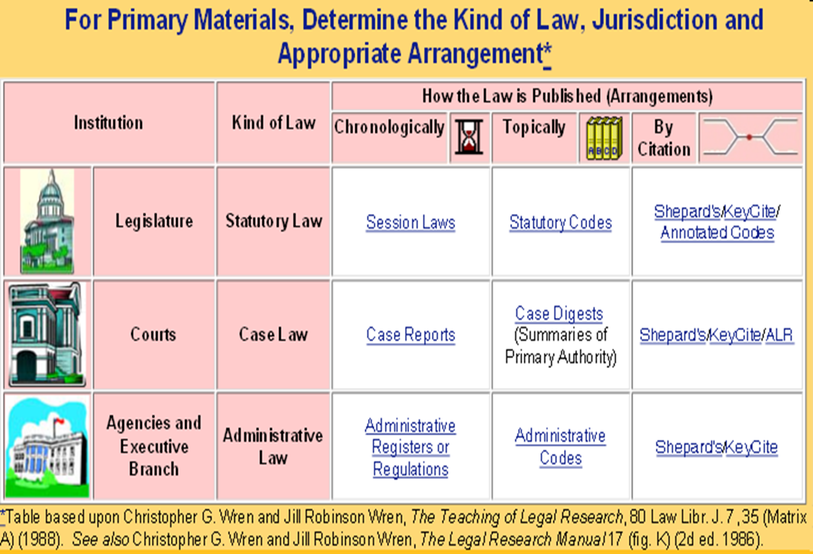
Surface Structure
We teach an intellectual process for the application of methods for legal research by:
Using a range of teaching methodologies and a mix of realistic problem types;
Showing the relationship of legal structure to legal tools and evaluating the appropriate use of those tools;
Inculcating the practice of iterative research strategies; and

Slide 9
Iterative Process
Notes:
Why didn’t they look for it? Well in part it is because of a misconception of their basic model of the research process—in seeing it like a baseball diamond in which they run around the bases and score a home run … and that then they are done—when in fact it is a cycle, and often when you get around that home plate, you find you have to keep running to the next base with a new issue. It’s a cyclical process, and so the students have had a failure, fundamentally, to conceptualize their schema of what research really is. When students consider the failure in their thinking, they are having a “METACOGNATIVE MOMMENT.”

Slide 10
Surface Structure
We teach an intellectual process for the application of methods for legal research by:
Using a range of teaching methodologies and a mix of realistic problem types;
Showing the relationship of legal structure to legal tools and evaluating the appropriate use of those tools;
Inculcating the practice of iterative research strategies; and
Providing regular assessment.

Slide 11
Deep Structure
The surface structure above enables students to master analytic and metacognitive approaches to:
Find and evaluate sources in the context of the legal questions;
Determine legal context, access authority, and understand how what is found relates to the legal question; and
Synthesize knowledge of the legal resources and institutional structures to implement research design, and evaluate and communicate the results.
Metacognition
Context
Synthesis
Notes:
Sources in the context of legal questions
Understanding one’s findings as it relates to the question
Synthesize resources and institutions to implement research design, evaluate, and communicate results.

Slide 12
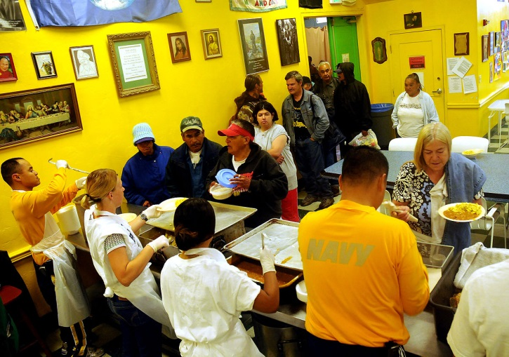
Notes:
The research problem first. I often assign the problem that class represents a coalition of churches that support soup kitchens, but who now want to sponsor a state constitutional amendment banning same sex marriage. Now the risk of doing this is that they might lose their tax exempt status. So we have decided to research the issue, and the students have been given some tools such as the CCH Standard Federal Tax Reporter . . . .

Slide 13
Typical Student Answer
Notes:
. . . And the typical student answer comes back that . . .

Slide 14
The churches would lose their tax exempt status
Notes:
The churches would lose their tax exempt status …

Slide 15
… because religious charities are only tax exempt if no substantial part of the organization’s activities … attempt to influence legislation.
See Reg. 1.105(c)(3)-1(c)(3)
Notes:
… because religious charities are only tax exempt if no substantial part of the organization’s activities … attempt to influence legislation. And then there is a regulation. So there is a no substantial part test. The students are proud of themselves that they have completed the assignment, …

Slide 16
Real research has only just begun
Notes:
But the real research has only just begun because the client will ask, “what does substantial” mean? The real research is just begun, … and how come none of the students researched the issue?

Slide 17
What is substantial?

Slide 18
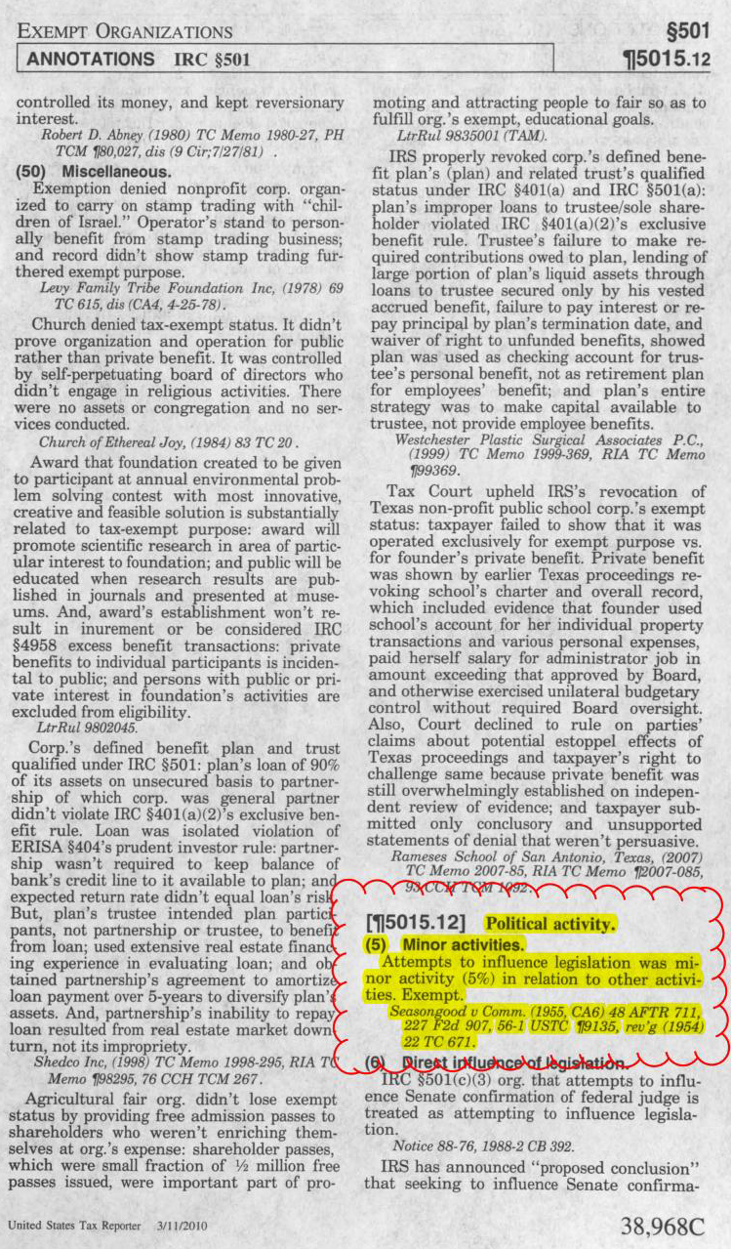
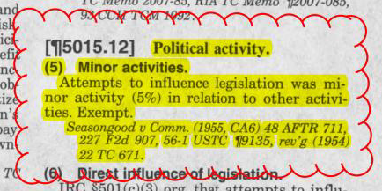
Notes:
If the students had researched the issue the students would have gone onto the annotation of some of the resources I had taught them and they might find that “attempts to influence legislation was minor activity”, 5% was ok and that that was considered exempt—a five percent test was ok. BUT the students didn’t even look for it—the meaning of substantial.

Slide 19
Baseball Diamond v.
Iterative Process
Notes:
Why didn’t they look for it? Well in part it is because of a misconception of their basic model of the research process—in seeing it like a baseball diamond in which they run around the bases and score a home run … and that then they are done—when in fact it is a cycle, and often when you get around that home plate, you find you have to keep running to the next base with a new issue. It’s a cyclical process, and so the students have had a failure, fundamentally, to conceptualize their schema of what research really is. When students consider the failure in their thinking, they are having a “METACOGNATIVE MOMMENT.”

Slide 20
Deep Structure
The surface structure above enables students to master analytic and metacognitive approaches to:
Find and evaluate sources in the context of the legal questions;
Determine legal context, access authority, and understand how what is found relates to the legal question; and
Synthesize knowledge of the legal resources and institutional structures to implement research design, and evaluate and communicate the results.
Metacognition
Context
Synthesis
Notes:
Sources in the context of legal questions
Understanding one’s findings as it relates to the question
Synthesize resources and institutions to implement research design, evaluate, and communicate results.

Slide 21

Tacit Structure
The surface structure models values, attitudes and norms of ethical professional behavior, including:
Professional duties, both while representing clients and researching for other purposes, which consist of, but are not limited to, accountability, honesty, thoroughness, cost and time-effectiveness, and balancing competing duties; and
Professional development, which incorporates but is not limited to critical self-assessment and critical strategic thinking, self-directed lifelong learning, problem solving, and the management of uncertainty and ambiguity within the research process.
Notes:
In Otto Preminger’s film, Anatomy of a Murder, Defense Counsel, Paul Biegler (played by Jimmy Stewart, does something incompressible in the modern practice of law. Mr. Biegler and his alcoholic colleague, actually choose to spend their leisure time drinking bourbon whisky and reading from case reporters—from Justice Holmes no less. See Anatomy of a Murder (Carlyle Productions, Inc. 1959).

Slide 22
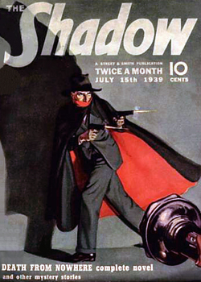
Shadow Structure
The surface structure can be limited because:
The curriculum often does not recognize legal research as a necessary, intellectual skill;
Legal research instruction is not appropriately integrated within the curriculum;
The academy often undervalues librarians as research experts and underutilizes them as research faculty; and
The legal education environment is necessarily a simulation, and is limited in its ability to provide a holistic context for client contact.
Notes:
In Otto Preminger’s film, Anatomy of a Murder, Defense Counsel, Paul Biegler (played by Jimmy Stewart, does something incompressible in the modern practice of law. Mr. Biegler and his alcoholic colleague, actually choose to spend their leisure time drinking bourbon whisky and reading from case reporters—from Justice Holmes no less. See Anatomy of a Murder (Carlyle Productions, Inc. 1959).

Slide 23
Signature Pedagogies
Surface
Deep
Tacit
Shadow

Slide 24
The COACh Template

Slide 25
COACh Template
Context
Objectives
Activities
Checklists

Slide 26
http://lawlibrary.colorado.edu/boulder-conferences-legal-research-education
- OR -
Just GOOGLE
It!

Slide 27


Slide 29
The End

