Slide 1

Licensing Information:
An Effort Towards Best Practices
Paul D. Callister, JD, MSLIS,
Library Director & Associate Professor of Law
Phill Johnson, JD, MSLIS
Associate Library Director, Adjunct Professor of Law & Director of Electronic Services & Communications
© 2008, some rights reserved. See http://creativecommons.org/licenses/by-nc-sa/3.0/us/

Slide 2
http://www1.law.umkc.edu/faculty/callister/presentations/licensing.ppt
THE FOLLOWING PRESENTATION IS FOR DISCUSIONAL PURPOSES ONLY AND SHOULD NOT BE CONSTRUED AS OR REPLACE THE NEED FOR OBTAINING LEGAL ADVICE. YOU SHOULD CONSULT AN ATTORNEY.

Slide 3
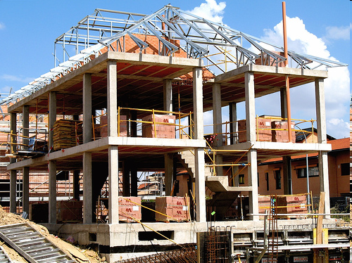
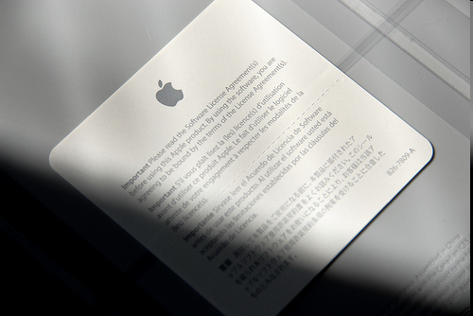
Framework of Licensing Issues
Choice of Law and Forum
Rights & Obligations
Warranties & Indemnification
Price
Default & Remedies
Termination & Cure
Formation & Modification
Software License Agreement Sticker by John Pastor. Source: http://www.flickr.com/photos/ttkgeek/2272824840/
‘House’ Frame by Ray Tibbits. Source: Flickr, at http://www.flickr.com/photos/aparejador/1393082783/

Slide 4

Choice of Law & Forum
  Source: NASA Visible Earth, at http://visibleearth.nasa.gov/view_rec.php?id=2429

Slide 5

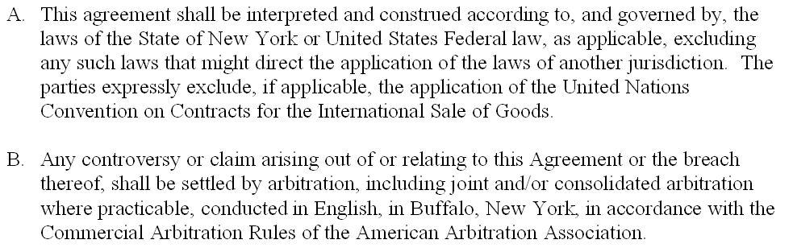
Choice of Law & Forum

Slide 6

Rights?
Who are the Authorized Users?
  Crash Test Dummy. Source: Athena Workman, at http://www.flickr.com/photos/athena1970/400016306/.

Slide 7
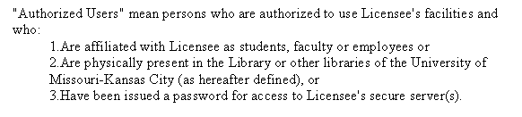
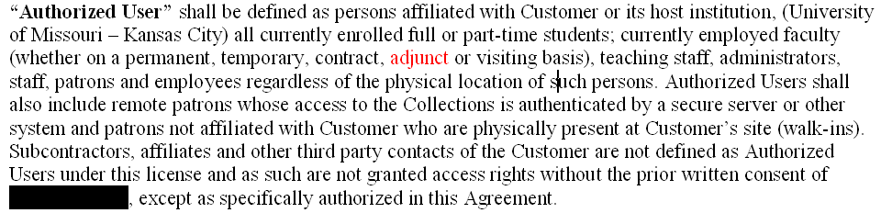
Users

Slide 8
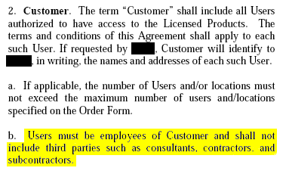
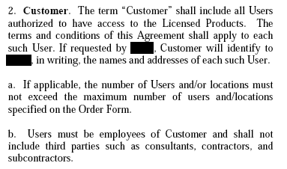
Users

Slide 9
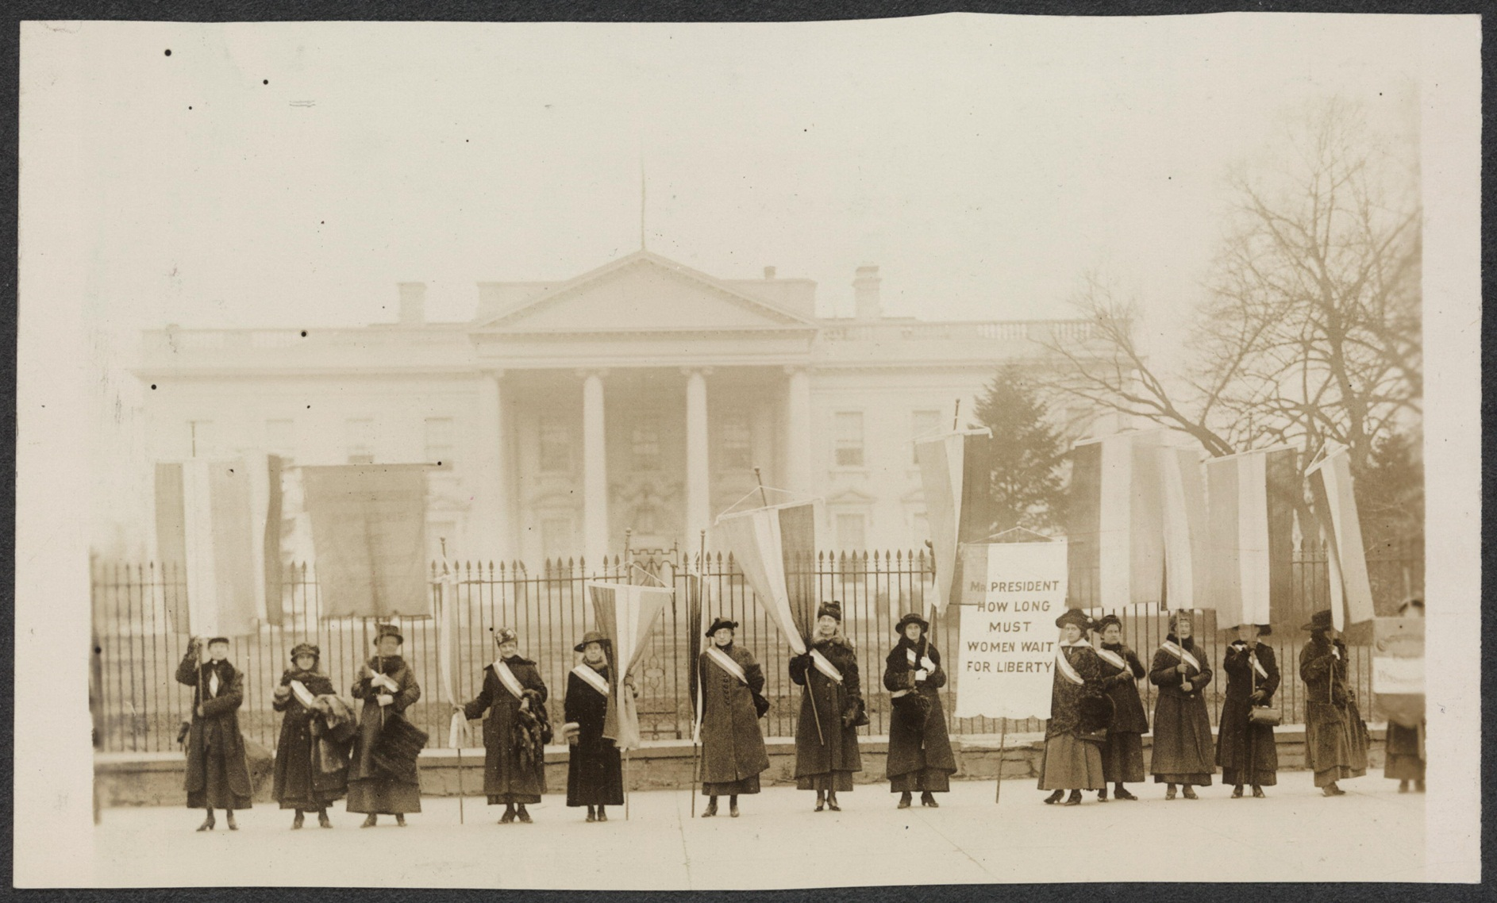
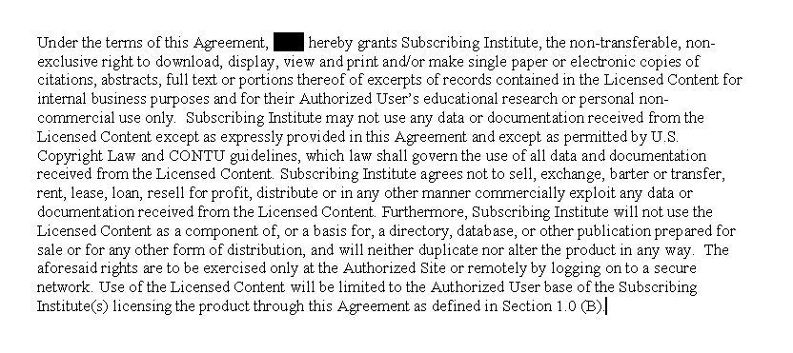
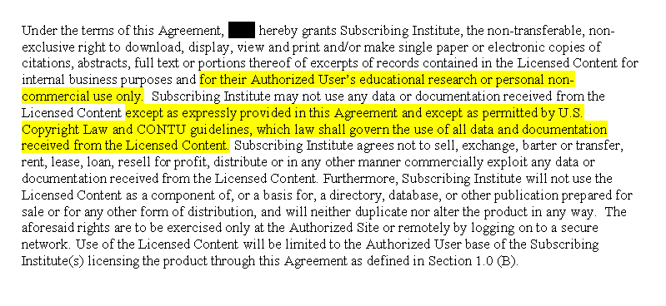
User Rights
  Women of Protest. Source: Library of Congress, American Memory Project, http://memory.loc.gov/ammem/collections/suffrage/nwp/

Slide 10
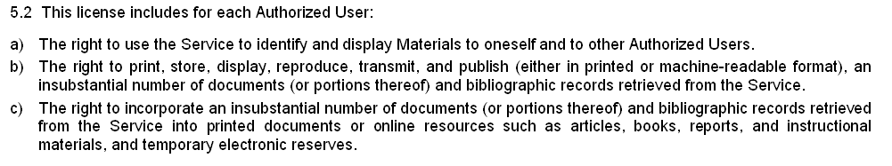
User Rights

Slide 11
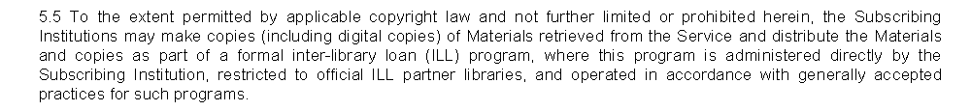
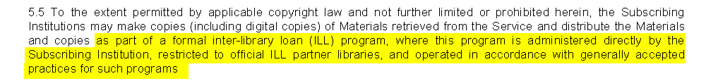
User Rights

Slide 12
User Rights
Customer may use the digital form for the purpose of supplying interlibrary loan requests in accordance with the Interlibrary Loan provisions of Section 108 of the US Copyright Law, provided however, that such requests may only be filled by the customer or customer’s Authorized Users, printing out a copy of the item to be provided and providing that print copy, or photocopy or fax copy of it, to the requesting party. Interlibrary loan may be facilitated through digital scanning (such as ARIAL), provided that no copies (by transmitting or receiving libraries) are stored from the scans, and that copies are delivered to requesting patrons in printed form only. . . . Nothing contained in this Section 4 shall be construed as permitting the Customer or its Authorized Users to, under any circumstance, provide a third party with access to, or a copy of, the Collection(s) in such a manner that such access and/or copy would supplant such third party’s need to obtain a license to access and use the Collection(s) from Thomson Gale.

Slide 13
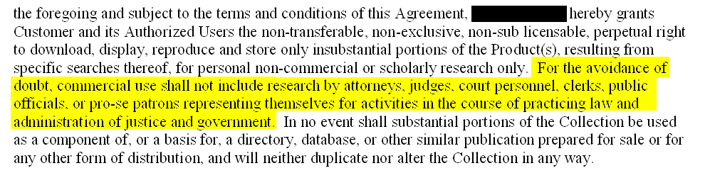
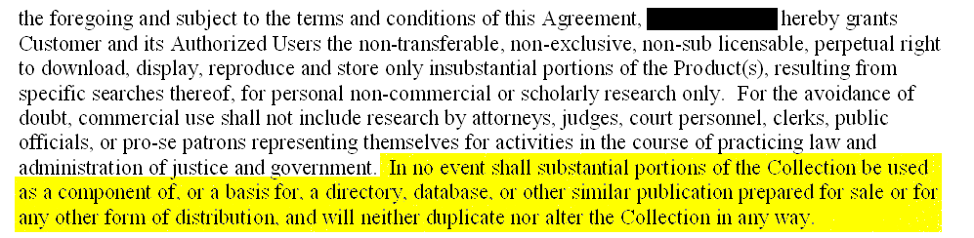
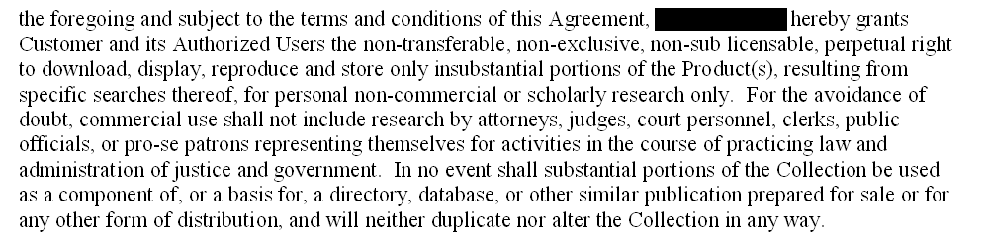
User Rights

Slide 14
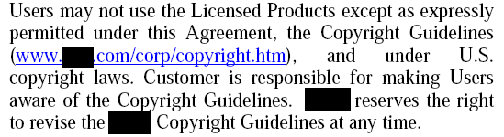
Customer & User Obligations

Slide 15
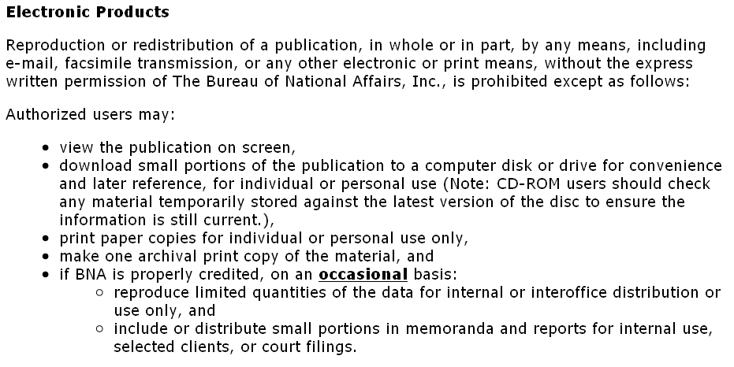
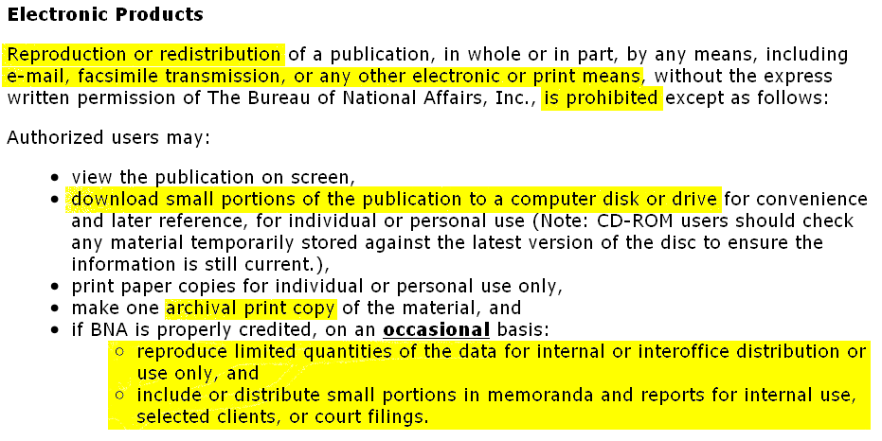
Incorporated User Obligations

Slide 16
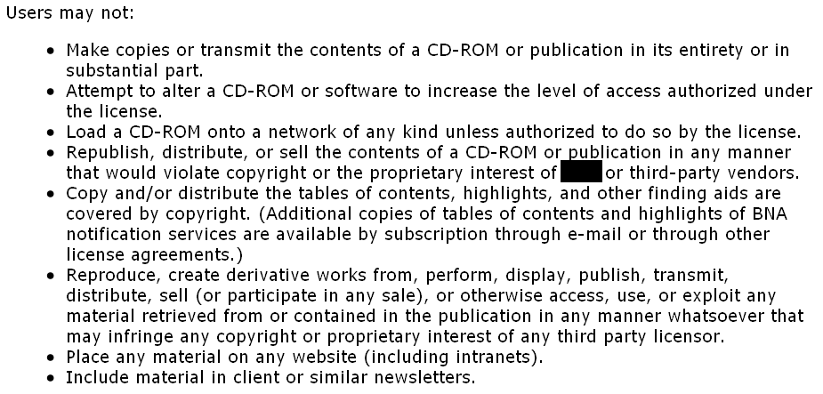
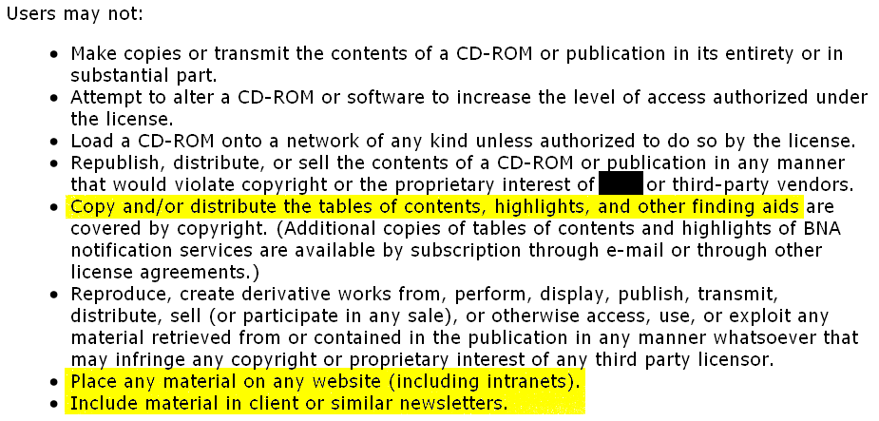
Incorporated Customer/User Rights

Slide 17
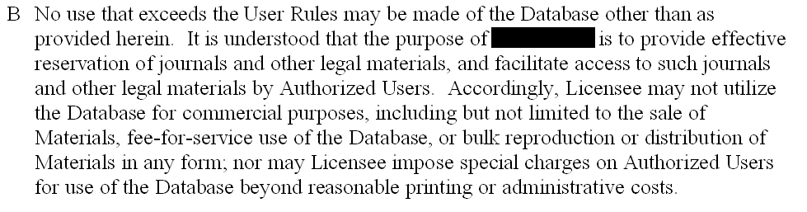
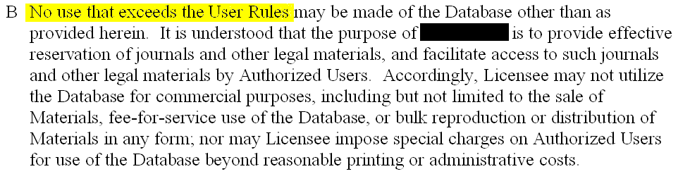
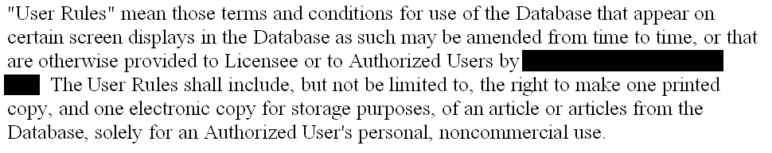
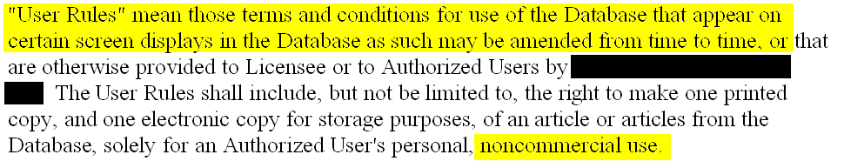
Incorporation by Reference

Slide 18

Warranties

Slide 19
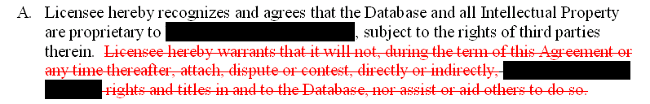
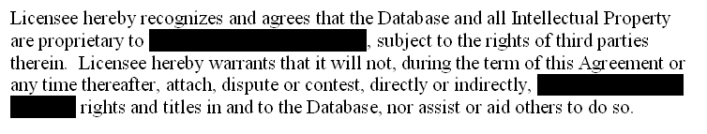
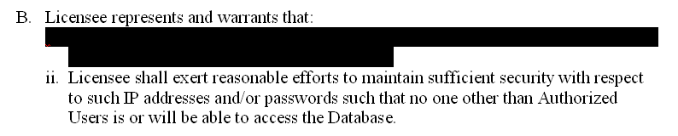
Subscriber Warranties

Slide 20
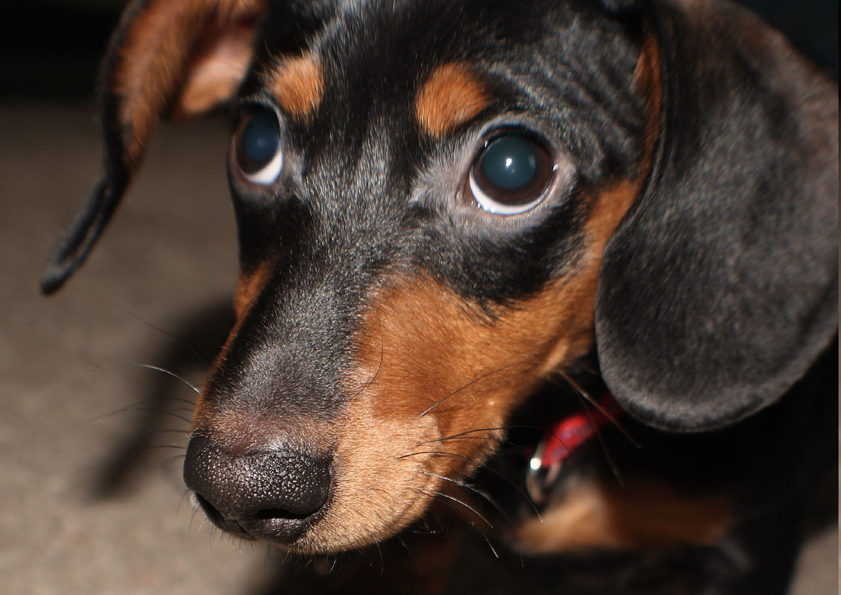
Bad EULA!
The EULA contains the following language: YOU SHOULD CAREFULLY READ THE FOLLOWING END USER LICENSE AGREEMENT BEFORE INSTALLING THIS SOFTWARE PROGRAM. BY INSTALLING, COPYING, OR OTHERWISE USING THE SOFTWARE PROGRAM YOU AGREE TO BE BOUND BY THE TERMS OF THIS AGREEMENT. IF YOU DO NOT AGREE TO THE TERMS OF THIS AGREEMENT, PROMPTLY RETURN THE UNUSED SOFTWARE PROGRAM TO THE PLACE OF PURCHASE OR CONTACT BLIZZARD ENTERTAINMENT CUSTOMER SERVICE . . . FOR A FULL REFUND OF THE PURCHASE PRICE WITHIN THIRTY DAYS OF THE ORIGINAL PURCHASE.
. . . .
Subject to that Grant of License hereinabove, you may not, in whole or in part, copy, photocopy, reproduce, translate, reverse engineer, derive source code, modify, disassemble, decompile, create derivative works based on the Program, or remove any proprietary notices or labels on the Program without the prior consent, in writing, of Blizzard. (Emphasis added.)
Davidson & Assocs. v. Jung, 422 F.3d 630, 635 (8th Cir. Mo. 2005)
How Bad Dogs Get Off the Hook, by Darin. Source: http://www.flickr.com/photos/carquestguy/312960255/

Slide 21
Bad EULA!
Appellants contractually accepted restrictions on their ability to reverse engineer by their agreement to the terms of the TOU and EULA. "Private parties are free to contractually forego the limited ability to reverse engineer a software product under the exemptions of the Copyright Act[,]" Bowers v. Baystate Techs, Inc., 320 F.3d 1317, 1325-26 (Fed. Cir. 2003), and "a state can permit parties to contract away a fair use defense or to agree not to engage in uses of copyrighted material that are permitted by the copyright law if the contract is freely negotiated." Id. at 1337 (Dyk, J., dissenting). . . . Appellants expressly relinquished their rights to reverse engineer. Summary judgment on this issue was properly granted in favor of Blizzard and Vivendi.
Davidson & Assocs. v. Jung, 422 F.3d 630, 639 (8th Cir. Mo. 2005)

Slide 22
UCITA-Void for Violating Fundamental Public Policy
On the other hand, terms in a mass-market license that prohibit persons from observing the visible operations or visible characteristics of software and using the observations to develop non-infringing commercial products, that prohibit quotation of limited material for purposes of education or criticism, or that preclude a non-profit library licensee from making an archival (back-up) copy would ordinarily be invalid in the absence of a showing of significant commercial need.
UCITA SECTION 105., Comment 3

Slide 23
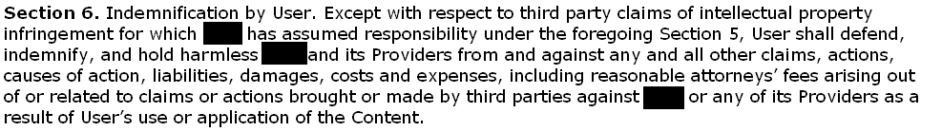
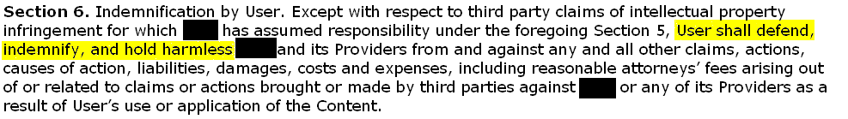

Subscriber/User Indemnification

Slide 24

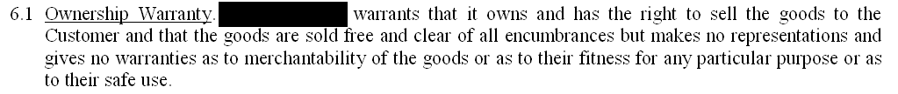
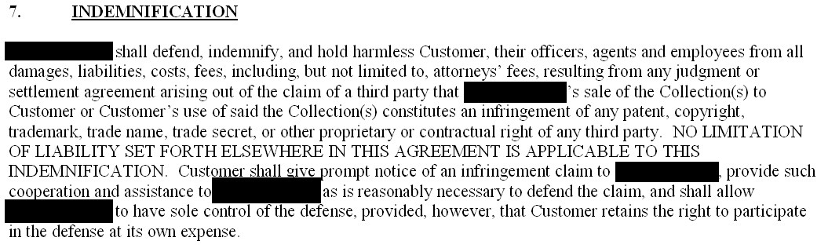
Vendor Warranties & Indemnification
Source: Microsoft Clip Art

Slide 25
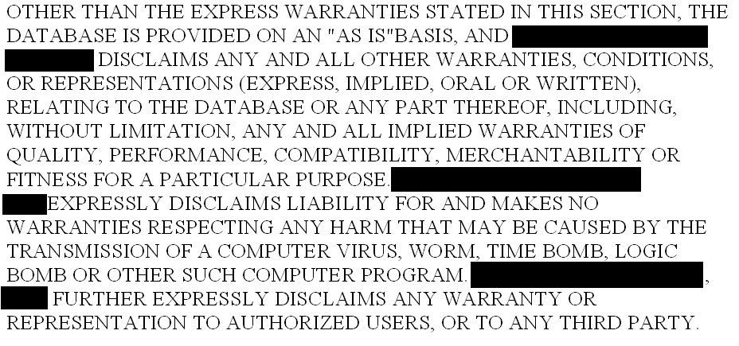
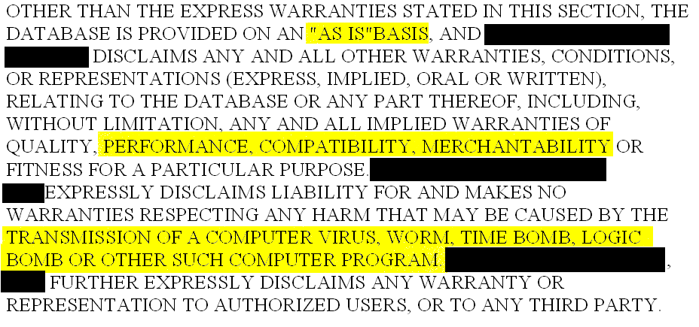
Vendor Warranties & Indemnification

Slide 26
Price
4.3 Most Favored Pricing. Thomson Gale agrees and covenants that the prices, discounts, concessions and payment terms contained in this Agreement are at least as favorable as those offered to any other individual library, as defined by the following Gale’s standard archival pricing criteria for (i) any individual academic institution; (ii) any individual academic institution with similar FTE and market size and; (iii) purchases outside of other library networks, consortium or grouping of libraries or library-related organizations.
4.4 Price Adjustment. Effective upon date of contract signing and continuing for three (3) years, in the event Thomson Gale deviates from the standard archival pricing criteria for an individual library (as defined in section 4.2) thereby resulting in a lower price offering of the Collection, Thomson Gale shall provide Customer with a $3,000.00 credit towards the purchase of a Thomson Gale or Primary Source Microfilm new product. Furthermore, to qualify for such a credit, there shall have been no changes, modifications or alterations to the Collection from date of contract signing through expiration of this offer.

Slide 27
Price
FTEs

Slide 28
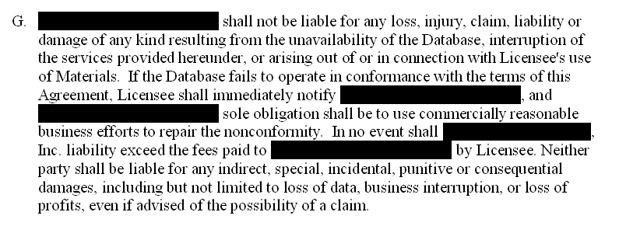
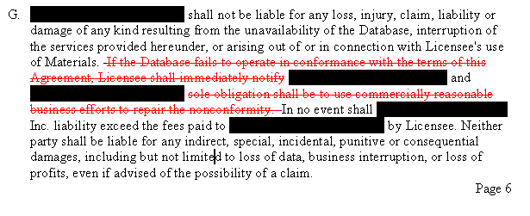
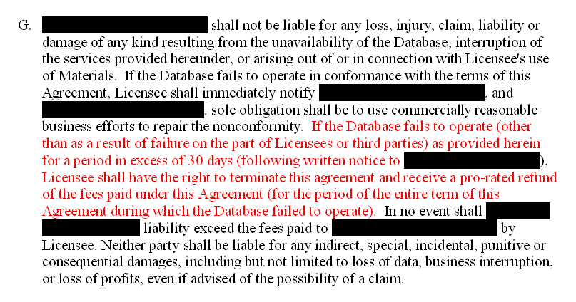
Remedies

Slide 29
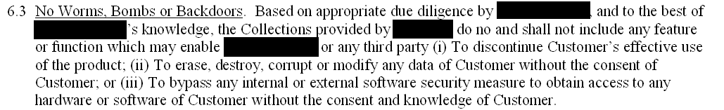
Remedies – Self Help

Slide 30
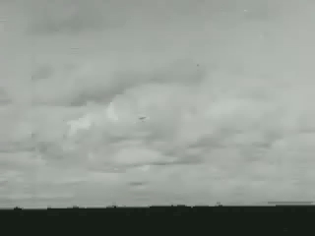
Termination—Denial of Services
  Underwater Atomic Bomb Test at Bikini Atoll (1946). Source: Internet Archive at http://www.archive.org/details/CEP00110.

Slide 31
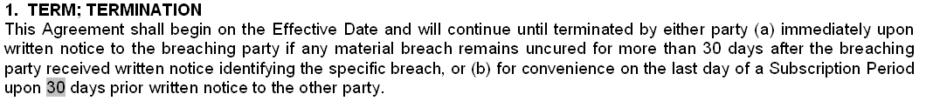
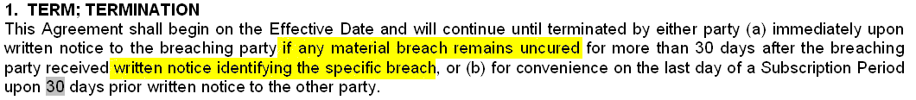
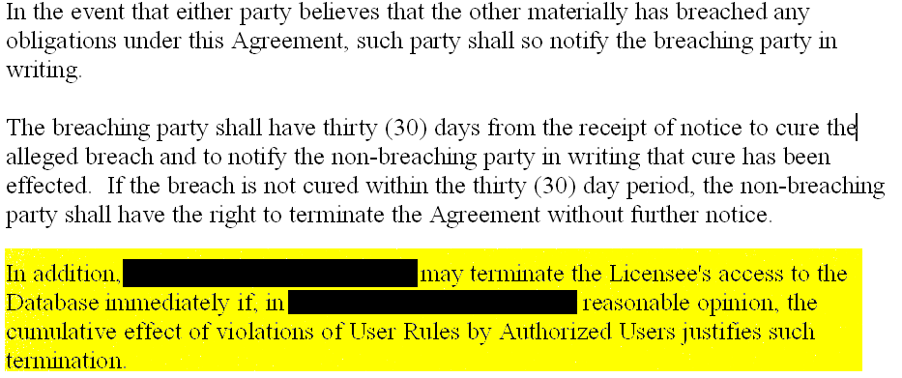
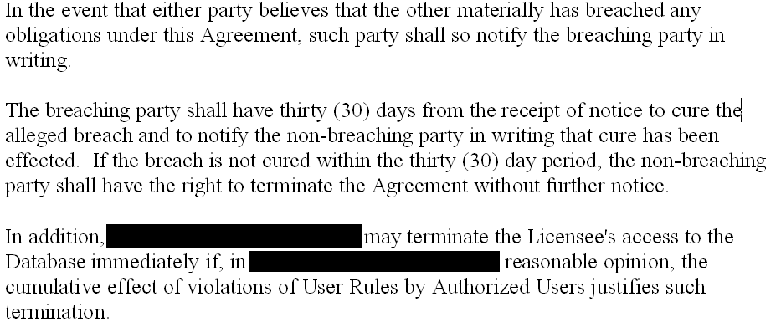
Termination

Slide 32
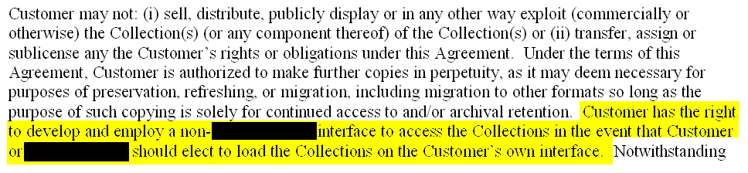
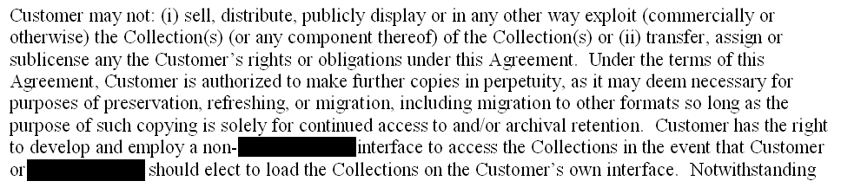
Termination

Slide 33
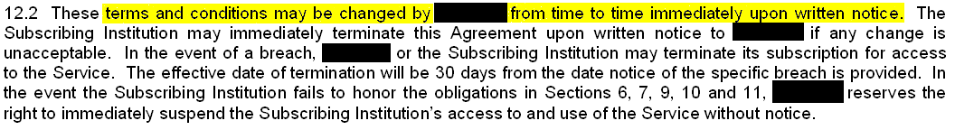
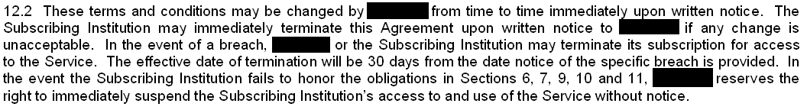
Modification

Slide 34
Best Practices
Choice of law & forum—home state advantage
Who is the licensor/vendor (in case you have to sue)?
Users– anyone that walks in, has a system log in, pick up adjuncts & independent contractors
Permissible Uses—practicing law, normal and digital ILL, digital course reserves, news letters, intranets, tables of contents
Reject CONTU limitations
Preserve fair use rights and public domain
Watch out for incorporated terms
Minimize duties to police and inform users
Don’t give away “intellectual property” or right to contest vendor’s interest (What are you contracting away?)

Slide 35
Best Practices
Limit your duty to indemnify
Vendor should warrant right to use material
Indemnification for claims based on infringement and viruses, worms, other damages to system
Remedies—subscriber has right to terminate and get back subscription fees if vendor breaches
Remedies—no self-help mechanisms (no “fooling with” subscriber’s machine or holding subscriber hostage)
Termination and denial of service only with reasonable time for cure
Reserve right to construct interface (for “owned” databases)
Only modify by written agreement (watch out for modifications “upon notice” to subscriber/user).

Slide 36
The End

